Slide 1
10.3
The Birth of the
Republican Party
The issue of slavery and other factors split political
parties
New parties are born
NEXT

Slide 2
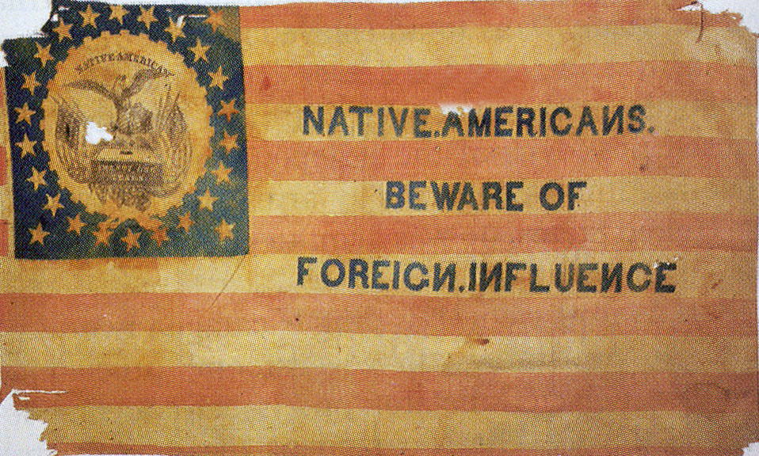
https://www.youtube.com/watch?v=uHXXfG5f81Y
SECTION
3
I. New Political Parties Emerge
A. Nativism
• belief in favoring native-born Americans over immigrants
• Nativists form American Party
(1854), known as Know-
Nothing Party
• Middle-class Protestants afraid
of Catholicism;
split over slavery
NEXT

Slide 3
SECTION
3
II. Antislavery Parties Form
A. The Free-Soilers
• Free-Soil Party opposes extension of slavery into territories
• Many Free-Soilers not abolitionists; support restrictions on blacks
• Object to slavery’s impact on white wage-based labor force
• Convinced of conspiracy to spread slavery throughout U.S.
NEXT

Slide 4
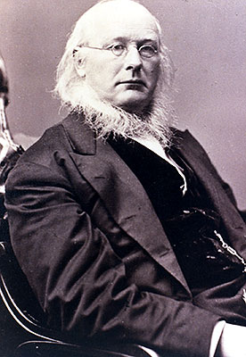
SECTION
3
B. Republican Party
• 1854, unhappy Whigs, Democrats, Free-Soilers form Republican Party
• Horace Greeley, abolitionist, helps found Rep. party
• Republicans oppose slavery in territories
• Main competition for voters is Know-Nothing Party
NEXT

