Slide 1
10.4
Slavery and Secession
Controversy brings the nation to the brink of
Civil War
NEXT

Slide 2
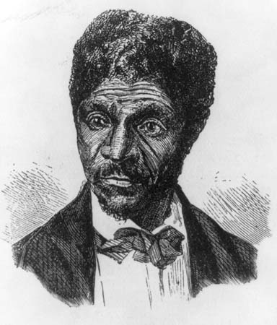
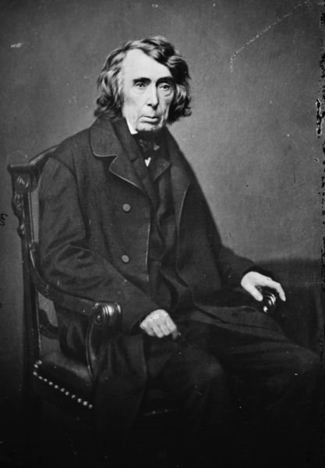
http://video.pbs.org/video/2298073069/
https://www.youtube.com/watch?v=1qlXBNwmoTw
SECTION
4
I. Slavery Dominates Politics
A. Dred Scott Decision
• Dred Scott, slave who had lived in free areas sues for freedom
• Chief Justice Roger B. Taney gives decision
- slaves do not have rights of citizens
- no claim to freedom, suit begun in slave state
- Congress cannot forbid slavery in territories
- Overturns the Missouri Compromise
B. The Lecompton Constitution
Proslavery Kansas government writes constitution, seeks statehood
NEXT

Slide 3
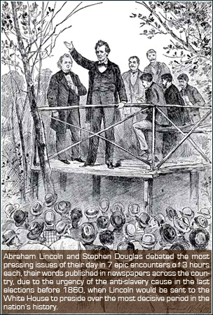
https://www.youtube.com/watch?v=2cYWUlEV3Mg
SECTION
4
II. Lincoln-Douglas Debates
A. Lincoln Challenges Douglas
1858, Republican Abraham Lincoln runs for Douglas’s Senate seat in the state of Illinois
Because Lincoln unknown, challenges Douglas to 7 debates
B. Positions and Arguments
Douglas: slavery backward, not immoral; Lincoln: slavery immoral
Douglas thinks popular sovereignty will undo slavery
Lincoln -legislation needed to stop spread of slavery
Both men distort other’s views, make them seem extreme
NEXT

Slide 4
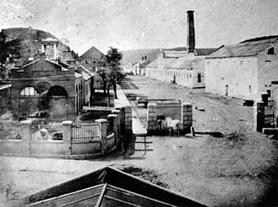
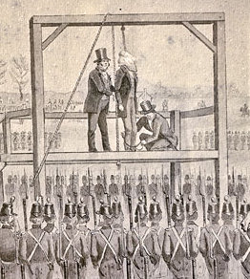
http://www.history.com/topics/harpers-ferry
SECTION
4
III. Passions Ignite
A. Harpers Ferry
John Brown plans to start a slave uprising, needs weapons
1859, leads band to federal arsenal in
Harpers Ferry to get arms
U.S. Marines put down rebellion, capture
Brown
The U.S. Armory at Harpers Ferry ca. 1862.
The Warehouse and the Smith and Forging Shop
are the first and second buildings on the right.
“John Brown's Fort” is the first building on the left.
B. John Brown’s Hanging
Brown is hanged for high treason, Dec. 1859
Many Northerners admire Brown; Southerners fear future uprisings
https://www.youtube.com/watch?v=NwvdeyUXeUA
NEXT

Slide 5
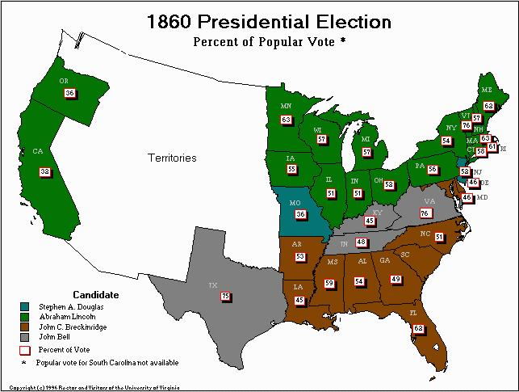
SECTION
4
IV. Lincoln Is Elected President
A. The Republican Convention
Overflowing crowds attend presidential
convention in Chicago
B. Seward and Lincoln
Sen. William H. Seward expected to
win nomination
Lincoln wins nomination; seen as
more moderate than Seward
- tells South will not meddle with
slaves; South feels threatened
C. The Election of 1860
Democrats split over slavery
Lincoln wins with less than half of popular
vote
- gets no Southern electoral votes
NEXT

Slide 6
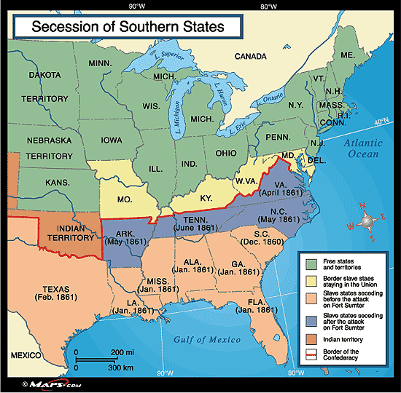
https://www.youtube.com/watch?v=roNmeOOJCDY
SECTION
4
V. Southern Secession
A. The Shaping of the Confederacy
SC and 6 other states secede:
- want complete independence from
federal control
- fear end to their way of life
- want to preserve slave labor system
Feb. 1861 Confederacy or Confederate
States of America forms
CSA permits slavery, each state is
sovereign
Former senator Jefferson Davis
unanimously elected president
NEXT

Slide 7
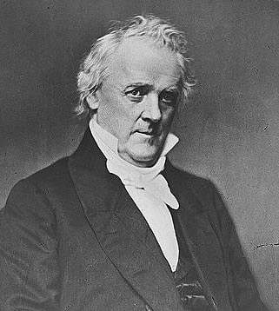
SECTION
4
B. The Calm Before the Storm
Buchanan calls secession illegal, says also illegal to stop it
Mass resignations from government in Washington, D.C.
NEXT

