Slide 1
11.2
The Politics of War
By issuing the Emancipation Proclamation, President Lincoln makes slavery the focus of the war.
NEXT

Slide 2
SECTION
2
I. Britain Remains Neutral
A. Britain Pursues Its Own Interests
Britain has cotton inventory, new sources; does not need South
chooses neutrality
NEXT

Slide 3
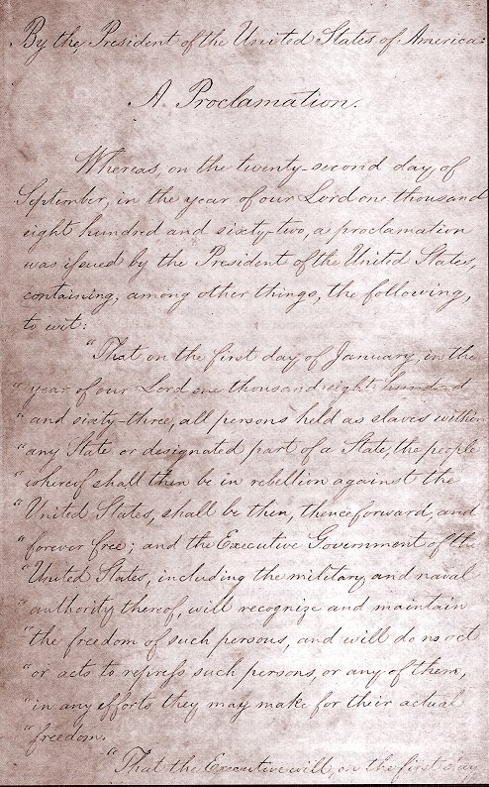
http://www.history.com/topics/american-civil-war/emancipation-proclamation
SECTION
2
II. Proclaiming Emancipation
A. Lincoln’s View of Slavery
Federal gov’t has no power to abolish slavery
where it exists
B. Emancipation Proclamation
• issued by Lincoln in 1863:
- frees slaves behind Confederate lines
- does not apply to areas occupied by Union or slave states in Union
Emancipation discourages Britain from supporting the South
Continued . . .
NEXT

Slide 4
SECTION
2
C. Reactions to the Proclamation
gives war high moral purpose
Free blacks welcome ability to fight against slavery
Confederacy becomes more determined to preserve way of life
Compromise no longer possible; one side must defeat the other
NEXT

Slide 5
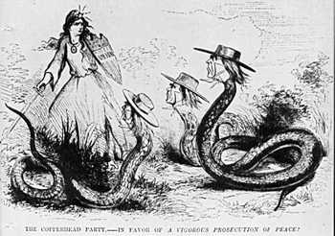
https://www.youtube.com/watch?v=4ZtztdWX0g8
SECTION
2
III. Both Sides Face Political Problems
A. Dealing with Dissent
• Both sides face divided loyalties
• Lincoln suspends habeas corpus:
- order to bring accused to court
• Copperheads—Northern Democrats
advocating peace—among arrested
• Davis denounces Lincoln, then suspends
habeas corpus in South
This political cartoon illustrates Republican opinions
of Copperheads.
Here, Lady Liberty fights off Copperhead leaders.
The cartoon first appeared in 1863, and depicts
a strong woman holding a sword and shield protecting
the "Union" from three faces of snakes, called "Copperheads."
Continued . . .
NEXT

Slide 6
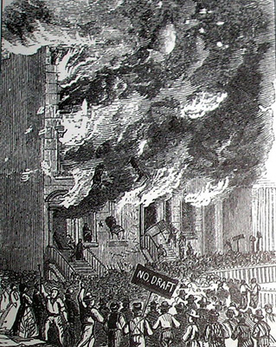
https://www.youtube.com/watch?v=x5kil3Pfkng
SECTION
2
B. Conscription
Casualties, desertions lead to draft
Both armies allow draftees to hire substitutes to serve for them
Planters with more than 20 slaves exempted
90% eligible Southerners serve; 92% Northern soldiers volunteer
C. Draft Riots
White workers fear Southern blacks will come North, compete for jobs
Angry at having to free slaves, mobs rampage through New York City
NEXT

