Slide 1
11.3
Life During Wartime
The Civil War brings about dramatic social and economic changes in American society.
NEXT

Slide 2
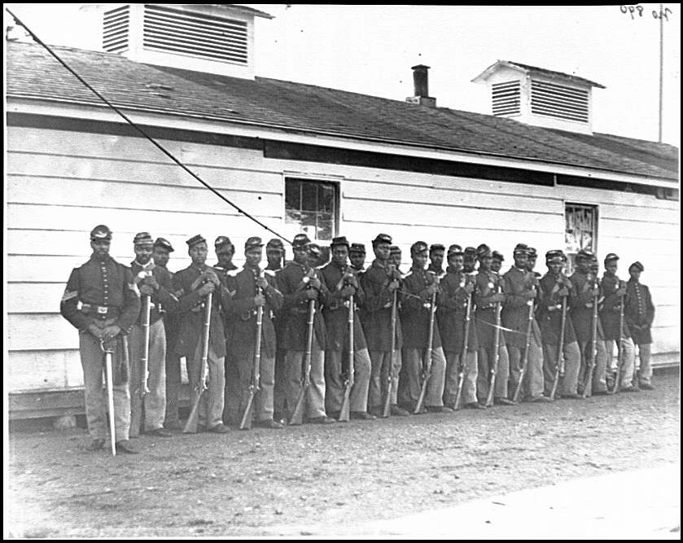
http://www.history.com/topics/american-civil-war/the-54th-massachusetts-infantry
SECTION
3
I. African Americans Fight for Freedom
A. African-American Soldiers
• Af-Ams 1% of North’s population, by war’s
end 10% of army
• Lower pay than white troops for most of
war; limits on military rank
• High mortality from disease; POWs killed
or returned to slavery
B. Slave Resistance in the Confederacy
Slaves seek freedom behind Union army
lines
On plantations, destroy property, refuse
to go with fleeing owners
NEXT

Slide 3
SECTION
3
II. The War Affects Regional Economies
A. Southern Shortages
Food shortages from lost manpower, Union occupation, loss of slaves
Blockade creates other shortages
B. Northern Economic Growth
Industries that supply army boom
Wages do not keep up with prices; workers’ standard of living drops
Women replace men on farms, city jobs, gov’t jobs
Congress establishes first income tax on earnings to pay for war
NEXT

Slide 4
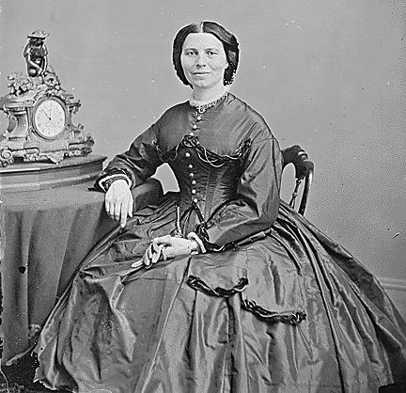
http://www.biography.com/people/clara-barton-9200960
SECTION
3
III. Soldiers Suffer on Both Sides
A. Lives on the Lines
Lack of sanitation, personal hygiene lead to disease in camp
Diets are unvaried, limited, unappealing
B. Civil War Medicine
U.S. Sanitary Commission works to better hygiene; hire, train nurses
- Union death rate drops
Surgeon general orders at least 1/3 of Union nurses be women
Union nurse Clara Barton serves on front lines
Southern women also volunteer as Confederate nurses
Continued . . .
NEXT

Slide 5
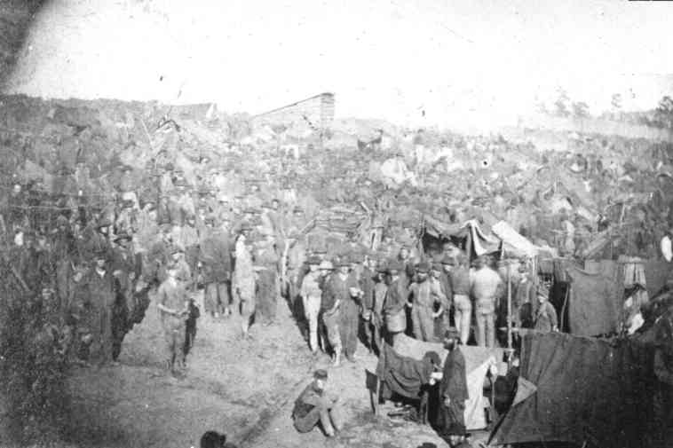
https://www.youtube.com/watch?v=HCdCcC1x3nA
SECTION
3
C. Prisons
• Living conditions in prisons worse than in army camps
• Andersonville—worst Confederate prison
- has no shelter,
sanitation; 1/3 of
prisoners die
• Northern prisons more
space, food, shelter than Southern
• 12% of Confederate
prisoners, 15% of
Union prisoners die
NEXT

