Slide 1
7.2
Nationalism at Center Stage
Nationalism exerts a strong influence in the courts, foreign affairs, and westward expansion in the early 1800s.
NEXT

Slide 2
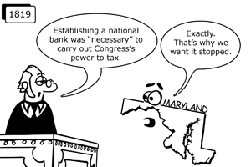
SECTION
2
I. The Supreme Court Boosts National Power
Strengthening Government
Economic Control
• Gibbons v. Ogden: federal govt
controls interstate commerce
• McCulloch v. Maryland: state
cannot overturn laws passed by
Congress
- Maryland denied the right to tax
the National Bank
https://www.youtube.com/watch?v=kKUpRFAi4vA
https://www.youtube.com/watch?v=TYxtCTIQNb4
NEXT

Slide 3
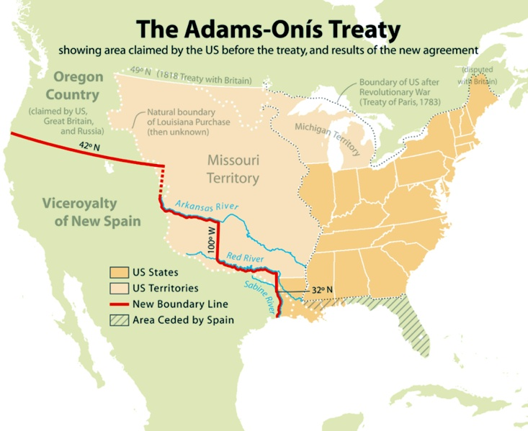
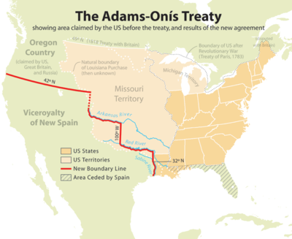
SECTION
2
II. Nationalism Shapes Foreign Policy
A. Territory and Boundaries
• Nationalism—national interests come before region, foreign concerns
• Spain cedes Florida to U.S. in Adams-Onís
Treaty
- defined western border of La. Territory
B. The Monroe Doctrine
• warns Europe not to interfere in Americas
(Western Hemisphere)
- U.S. will not interfere with Europe
- if European nations get involved in Western Hemisphere it is an act of war
http://www.history.com/topics/monroe-doctrine
Continued . . .
https://www.youtube.com/watch?v=8TdpX7gF5GI
NEXT

Slide 4
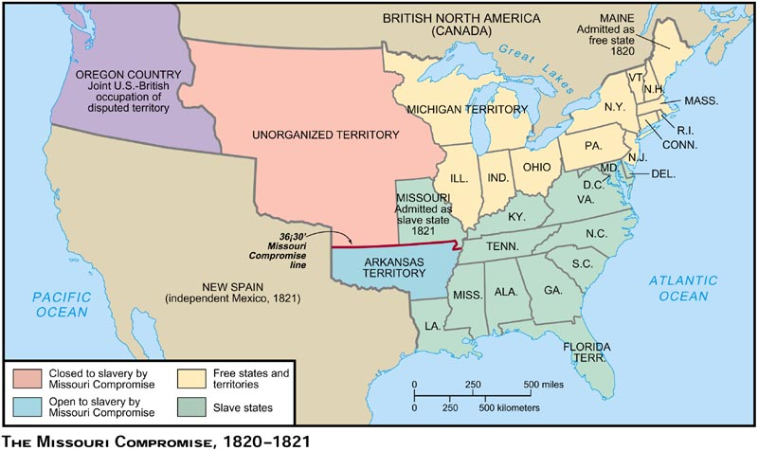
https://www.youtube.com/watch?v=JTSbn5cE4LA
SECTION
2
III. Nationalism Pushes America West
A. Expansion to the West
Most settlers go west for land, economic opportunity, and job change
B. The Missouri
Compromise
• When territory’s
population
reaches 60,000 may
apply for statehood
• Missouri Compromise
—preserves balance
between slave, free
states
- Maine admitted as free state,
Missouri as slave state
- divides La. Territory at 36°30’ line: slavery legal in south
NEXT

