Slide 1
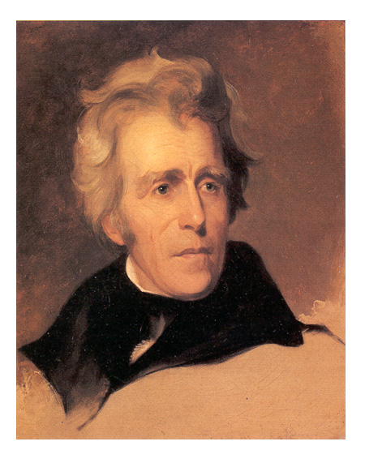
7.3
The Age of Jackson
Andrew Jackson’s policies speak for common people but violate Native American rights.
http://www.youtube.com/watch?v=beN4qE-e5O8
NEXT

Slide 2
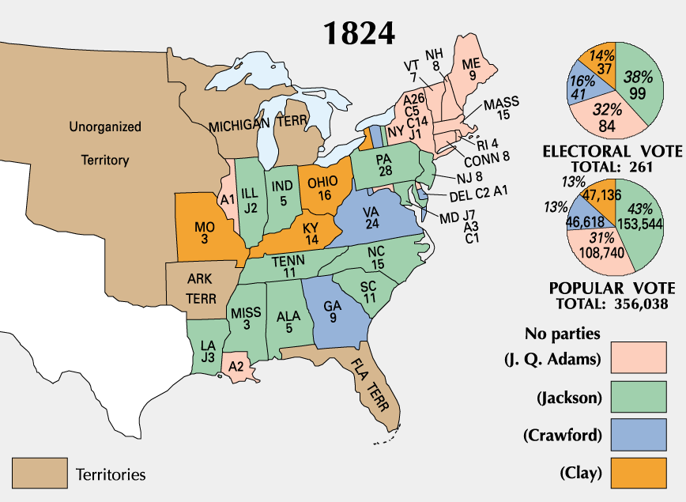
http://www.youtube.com/watch?v=XPIURHVK9oo
SECTION
3
I. Expanding Democracy Changes Politics
A. Tension Between Adams and
Jackson
• In 1824, Andrew Jackson wins popular
but not electoral vote
• John Q. Adams elected president by House
with Clay’s support
• Jacksonians claim Adams, Clay have
struck a “corrupt bargain”
• Jacksonians form Dem-Rep Party,
block Adams’s policies
B. Democracy and Citizenship
Most states ease voting qualifications;
few require property
In 1828, numerous new voters help
Jackson win presidency
NEXT

Slide 3
SECTION
3
II. Jackson’s New Presidential Style
A. Jackson’s Appeal to the Common Citizen
• Jackson claims he is of humble origins, though in reality is wealthy
• Jackson wins 1828 presidential election by landslide
B. Jackson’s Spoils System
• Uses spoils system —replaces former appointees with own friends
• Friends become primary advisers, dubbed “kitchen cabinet”
http://www.youtube.com/watch?v=MsHvJcGwRG4
NEXT

Slide 4
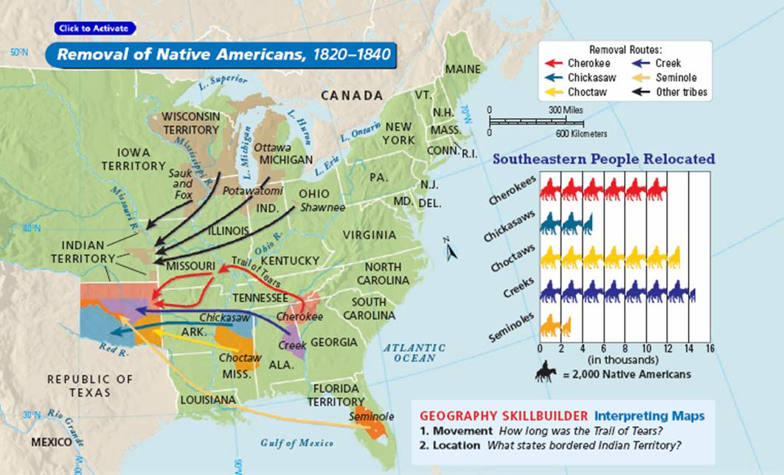
SECTION
3
III. Removal of Native Americans
A. Indian Removal Act of 1830
• Whites want to displace or assimilate Native Americans
• Jackson: only solution is move N-Ams off their land
- thinks assimilation cannot
work
- too many troops needed to
keep whites out of native
lands
• Congress passes Indian
Removal Act of 1830
- funds treaties that force
N-Ams west
• Jackson pressures some
tribes to move, forcibly
removes others
Continued . . .
NEXT

Slide 5
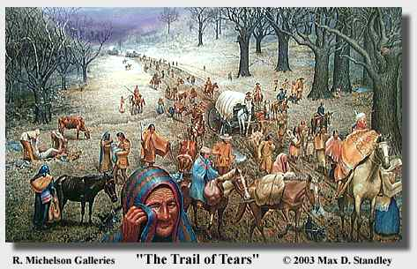
SECTION
3
B. The Cherokee Fight Back
Worcester v. Georgia —state cannot rule Cherokee or invade their land
Federal agents sign treaty; relocation begins
President Martin Van Buren orders removal
C. The Trail of Tears
Cherokee sent west on Trail of Tears; 800-mile trip made on foot
Cherokee are robbed by govt officials,
outlaws; thousands die
http://www.history.com/topics/native-american-history/trail-of-tears
NEXT

