Slide 1
8.3
Women and Reform
Women reformers expand their efforts from movements such as abolition and temperance to include women’s rights.
NEXT

Slide 2
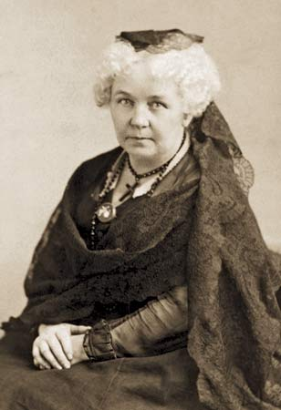
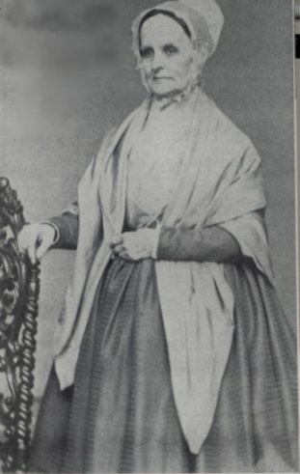
http://www.biography.com/people/elizabeth-cady-stanton-9492182
SECTION
3
I. Women’s Roles in the Mid-1800s
A. Cultural and Legal Limits on Women
• Cult of domesticity —only housework, child care for married women
• women earn 1/2 of men’s pay for same job
• have few legal rights; cannot vote, sit on juries
- do not have guardianship of own children
• A married woman’s property, earnings belong to her husband
• Women delegates at World’s Anti-Slavery Convention rejected
• Elizabeth Cady Stanton, Lucretia Mott form women’s rights society
NEXT

Slide 3
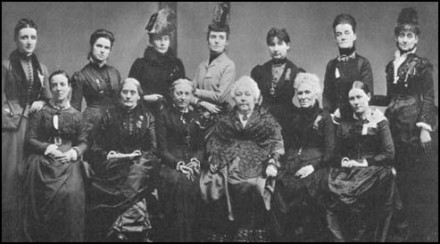
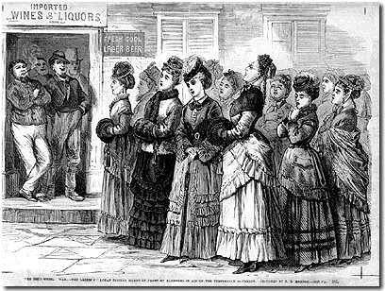
SECTION
3
II. Women Mobilize for
Reform
A. Women Abolitionists
• Middle-class white women inspired
by religion join reform movements
• Sarah and Angelina Grimké—
work for abolition
The "Ladies of Logan" sing hymns in front
of bars in aid of the temperance movement
B. Working for Temperance
• Many women in temperance movement—
prohibit drinking alcohol
• American Temperance Society founded
to end widespread use of alcohol
Continued . . .
NEXT

Slide 4
SECTION
3
C. Education for Women
• Until 1820s, few opportunities for girls past elementary school
• Academic schools for women become available
• Af-Am. girls have few opportunities to get good education
Continued . . .
NEXT

Slide 5
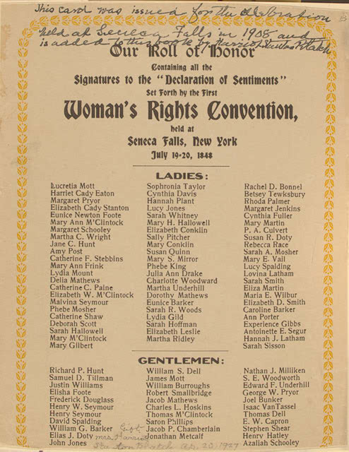
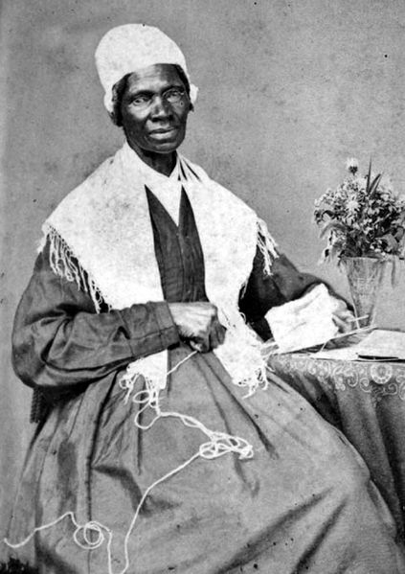
http://www.biography.com/people/sojourner-truth-9511284
SECTION
3
III. Women’s Rights Movement
Emerges
A. Seneca Falls
1848, Stanton/Mott hold Seneca Falls Convention for women’s rights
“Declaration of Sentiments” modeled on Dec. of Ind.
Attendees approve all but one resolution of Declaration unanimously:
- men and women are equal
- urge women to participate in public issues
- narrowly pass women’s suffrage
B. Sojourner Truth
Former Northern slave travels country preaching
Later argues for abolition, women’s rights
Continued . . .
NEXT

