Slide 1
9.3
Expansion in Texas
American settlers invited to Texas. Conflict develops over religion and the issue of slavery.
NEXT

Slide 2
SECTION
3
I. Americans Settle in the Southwest
A. The Impact of Mexican Independence
Mexico encourages trade between U.S. and northern provinces
Native American groups threaten scattered Mexican settlements
B. Mexico Invites U.S. Settlers
To protect territory, Mexico encourage U.S. farmers to go to Texas
Offers land grants to empresarios (agents) who sell land cheaply
Continued . . .
NEXT

Slide 3
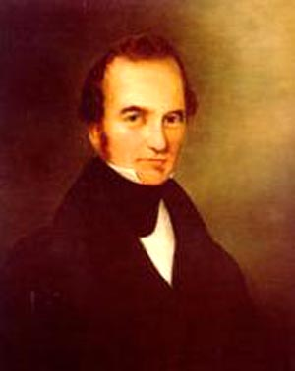
SECTION
3
C. Austin in Texas
• Stephen F. Austin, successful empresario, establishes colony in 1821
• U.S. wants lands south to Rio Grande; Mexico refuses to sell Texas
NEXT

Slide 4
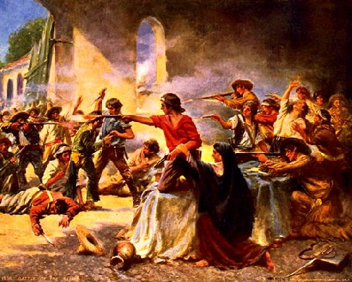
http://www.history.com/topics/alamo
http://www.history.com/topics/alamo/videos/deconstructing-history-alamo
SECTION
3
II. Texas Fights for Independence
A. “Come to Texas”
Cultural differences arise between Anglos and Mexico:
- Anglos speak English, not Spanish
- Southerners bring slaves; Mexico
abolished slavery
American settlers greatly outnumber
Mexican settlers
Mexican president Antonio López
de Santa Anna imprisons Austin
- revokes local powers; rebellions
erupt, including Texas Revolution
B. “Remember the Alamo!”
Santa Anna marches to Texas;
Austin tells Texans to arm
themselves
Santa Anna storms Alamo all 187
U.S. defenders killed
Continued . . .
NEXT

Slide 5
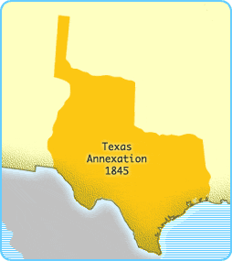
SECTION
3
C. The Lone Star Republic
• Sam Houston defeats, captures Santa Anna at Battle of San Jacinto
• Treaty of Velasco gives Texas independence-1836
• Houston becomes president of the Republic of Texas
D. Texas Joins the Union
• 1838, Houston invites U.S. to annex Texas
• South favors, North opposes annexation; Texas becomes state in 1845
https://www.youtube.com/watch?v=YLB5rH9eTBI
NEXT

