Slide 1
http://www.cbsnews.com/news/americas-forgotten-war-south-of-the-border/
9.4
The War with Mexico
War with Mexico, Gold in California.
NEXT

Slide 2
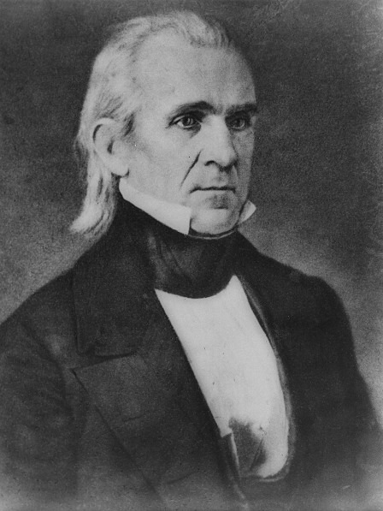
SECTION
4
I. Polk Urges War
A. “Polk the Purposeful”
• President James K. Polk favors war with Mexico
- believes U.S. will get Texas, NM, California
B. Sectional Attitudes Toward War
South favors war to extend slavery, increase power in Congress
North opposes war, fears spread of slavery, Southern control of U.S.
Continued . . .
NEXT

Slide 3
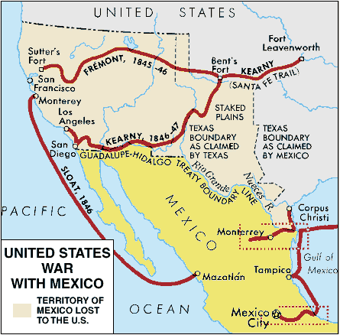
SECTION
4
II. The War Begins
A. Polk Provokes War
U.S. repeatedly violates Mexico’s
territorial rights
Polk sends war message to Congress,
withholds facts
Congress approves war, stifles
opposition
New Mexico surrenders to U.S. without
a fight
B. The War in Mexico
U.S. has many military victories; Mexican troops have poor leaders
Invasion of Mexico led by generals Zachary Taylor, Winfield Scott
Polk helps Santa Anna regain power, but Santa Anna fights U.S.
Continued . . .
NEXT

Slide 4
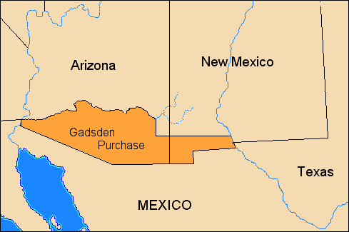
SECTION
4
III. America Gains the Spoils of War
A. The Treaty of Guadalupe Hidalgo
U.S. and Mexico sign Treaty of Guadalupe Hidalgo in 1848
-Texas border set at Rio Grande
- Mexico cedes western lands for
$15 million
- guarantees rights of Mexicans
living in territories
War enlarges U.S. territory by about
1/3
Pierce authorizes 1853 Gadsden
Purchase, sets final border
https://www.youtube.com/watch?v=gn2FzuPyFlY
NEXT

Slide 5
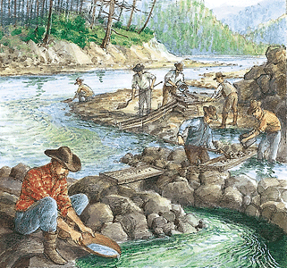
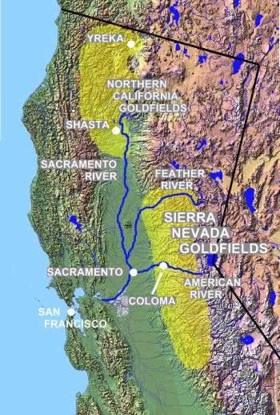
http://www.history.com/topics/gold-rush-of-1849
SECTION
4
IV. The California Gold Rush
A. The Rush Begins
• 1848, gold discovered at Sutter’s Mill in California Sierra Nevadas
• San Fran residents abandon city to find gold
• Gold rush, or migration of prospectors to California in 1849
• Forty-niners, gold prospectors, come from Asia, South America, Europe
Continued . . .
NEXT

Slide 6
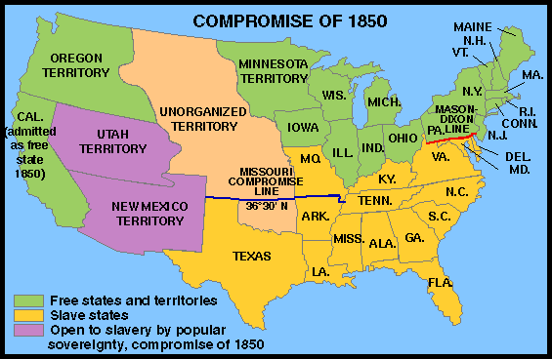
SECTION
4
B. Gold Rush Brings Diversity
By 1849, California’s population exceeds 100,000
Chinese, free blacks, Mexicans migrate in large numbers
Slavery permitted until outlawed by 1849 constitutional convention
California joins Union
in 1850 by way of
Compromise of 1850
https://www.youtube.com/watch?v=uvlUqV1vwTc
https://www.youtube.com/watch?v=tkdF8pOFUfI
NEXT

