Slide 1
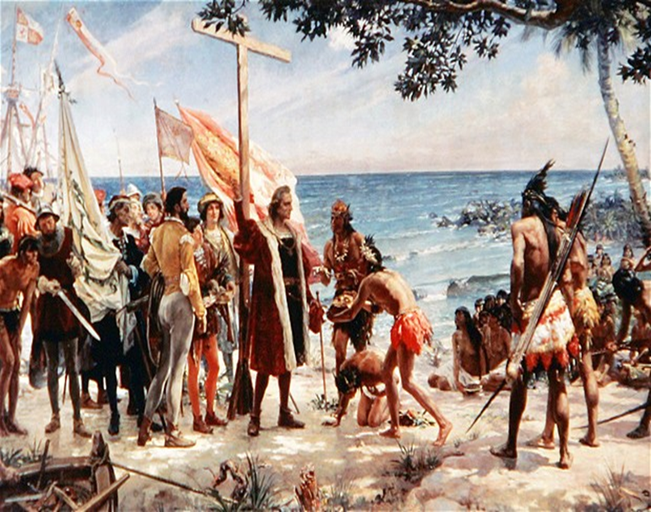
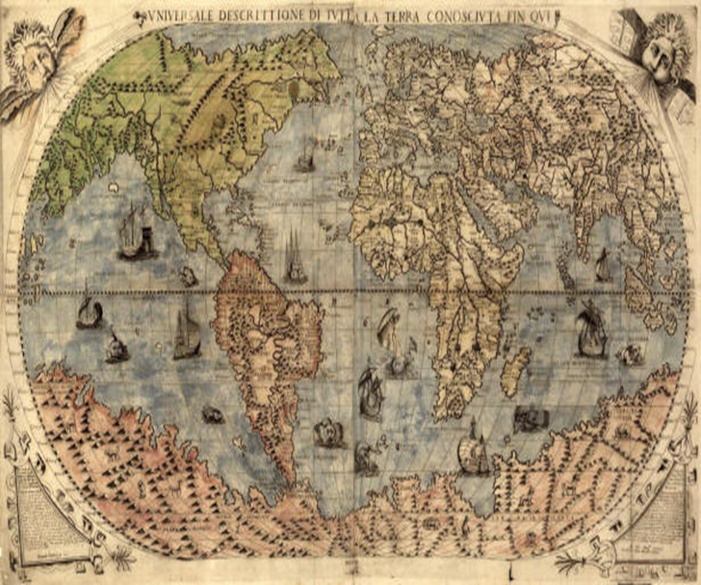
Chapter 1:
Three Worlds Meet
Native Americans and Africans develop complex societies and cultures. Europeans explore and conquer parts of the New World and launch a massive slave trade.

Slide 2
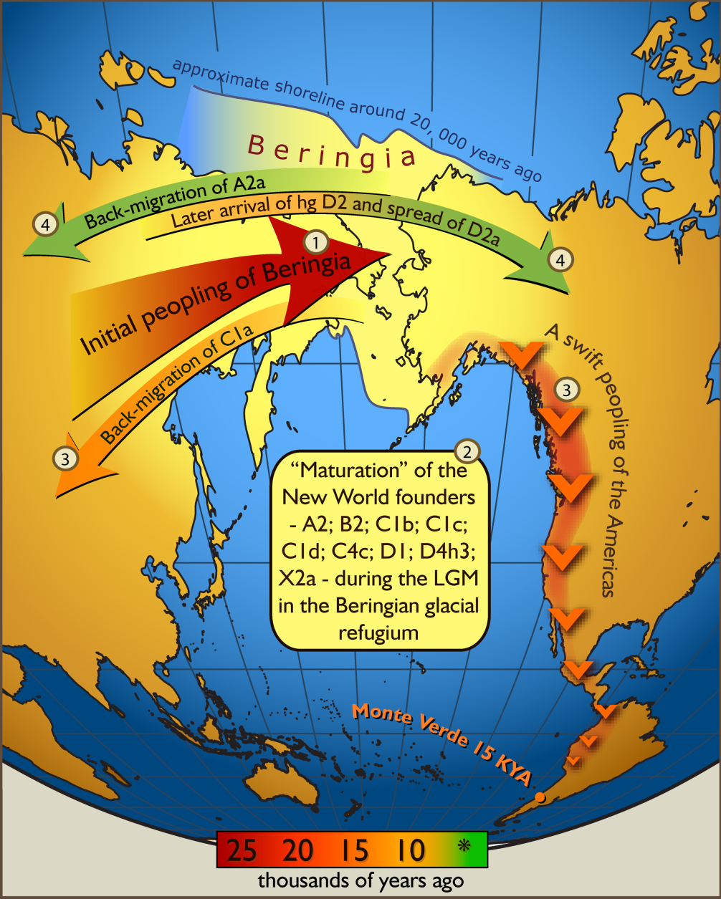
1.1
Peopling the Americas
In ancient times, migrating peoples settle the Americas, where their descendants develop complex societies.

Slide 3
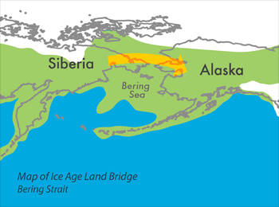
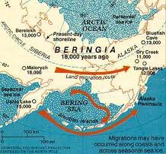
I. Ancient Peoples Come to the Americas
A. The First Americans
• 22,000 years ago hunters cross from Asia to Alaska over Beringia
B. Hunting and Gathering
• Inhabitants hunt large animals until climate warms
• 12,000 to 10,000 years ago hunt small game, gather nuts and berries
C. Agriculture Develops
• Planting of crops begins in central Mexico 10,000 to 5,000 years ago
• Some cultures remain nomadic—moving in search of food and water

Slide 4
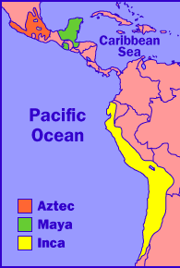
II. Complex Societies Flourish in the Americas
A. Early Cultures of the Americas
• About 3,000 years ago, inhabitants begin forming large communities
B. Empires of Middle and South America
• The Olmec flourish 1200 to 400 B.C. along Gulf of Mexico
• A.D. 250 to 900, Maya culture thrives in Guatemala and Yucatán
• Aztec begin building civilization in the Valley of Mexico in 1200s
• Inca establish empire around A.D.1200 in western South America
• Cultures have cities or ceremonial centers; some have writing
http://www.history.com/topics/maya

Slide 5
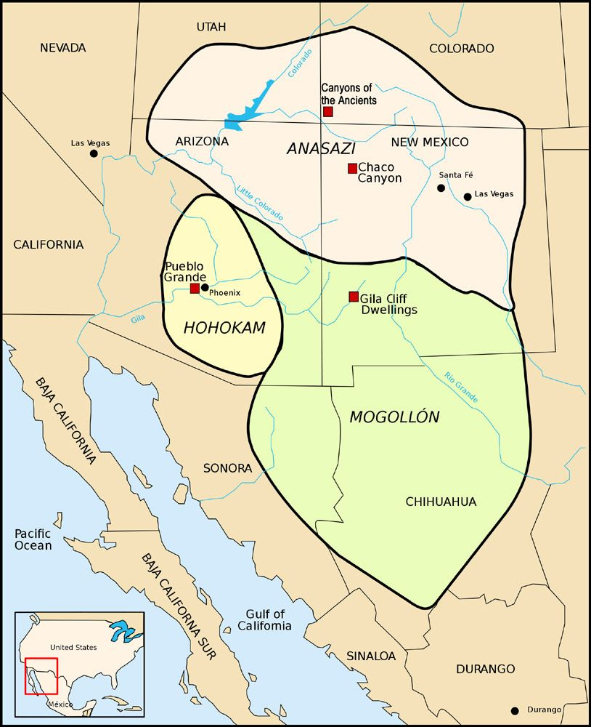
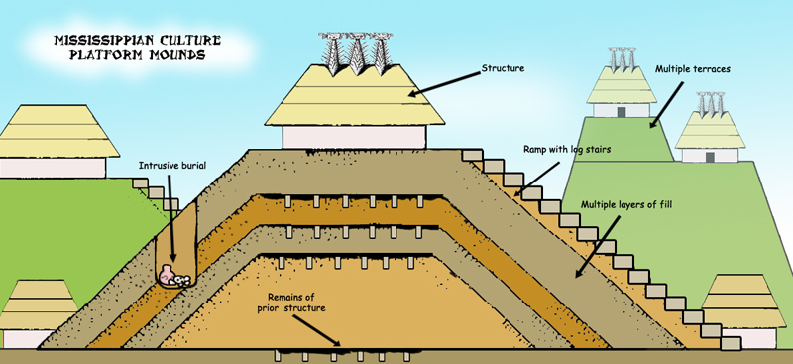
C. Ancient Desert Farmers
• About 3,000 years ago, groups begin growing crops in Southwest
• Groups establish civilizations, 300 B.C. to A.D. 1400
- Hohokam settle in river valleys
- Anasazi live in mesa tops, cliff sides, canyons
D. Mound Builders
• In East, Adena, Hopewell, Mississippian establish trading societies
• Adena, Hopewell build huge burial and animal-shaped mounds
• Mississippian people build giant pyramidal mounds
https://www.youtube.com/watch?v=Yg9ZXvulMQE

