Slide 1
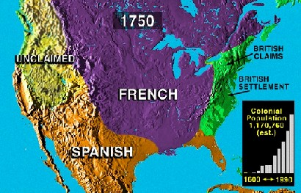
France’s Empire
-French areas of colonization
-St. Lawrence River Valley,
-Quebec,
- Great Lakes,
-Louisiana
-Interest in trading not colonizing
-better relationship with Indians
-English colonists want to expand

Slide 2
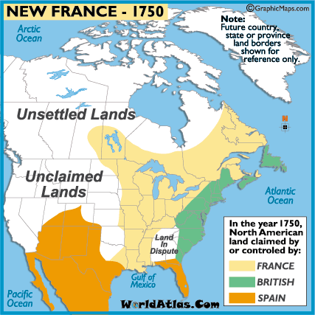
France’s Empire
-Indians resist and ally with French
-Old rivalry with Britain
-multiple wars fought between French and English in past centuries
-1754 conflict ignites again as French begin building forts near Virginia border

Slide 3
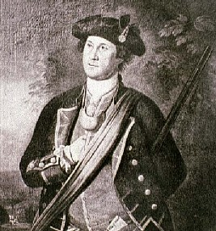
War started in Europe (The Seven Years War) and spilled into the colonies 1754-1763
French and Indian War
-Virginia Gov’t sends George Washington led militia against the French - Britain and France fought for control of the Ohio Valley and Canada
-The French and Indian allies won many early battles - The Algonquins, who feared British expansion into the Ohio Valley, allied with the French. The Mohawks also fought for the French while the rest of the Iroquois Nation allied with the British.
-Albany Plan of Union – “Join or Die” Colonies must unite against France
colonies debate forming central government

Slide 4
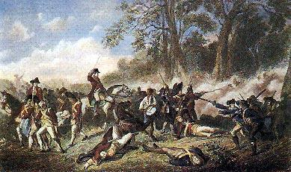
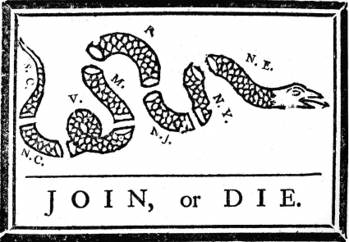
French and Indian War
-Virginia Gov’t sends George Washington led militia against the French
-The French and Indian allies won many early battles
-Albany Plan of Union
colonies debate forming central government
Credited to Benjamin Franklin. Originally appeared in French and Indian War and later recycled to encourage colonies to fight against the British

Slide 5
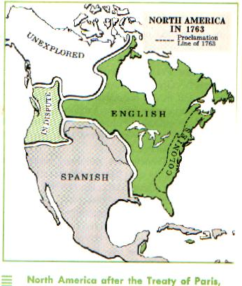
French and Indian War
-Victory at Quebec finally gave the British control of the region
-turning point of the conflict – significance France cedes majority of lands to British. Spain gives Florida to British, but Spain controls Louisiana territory (for now).
- Britain is dominant power in North America
-Treaty of Paris, 1763 – ends the war
-France lost all lands in America

Slide 6
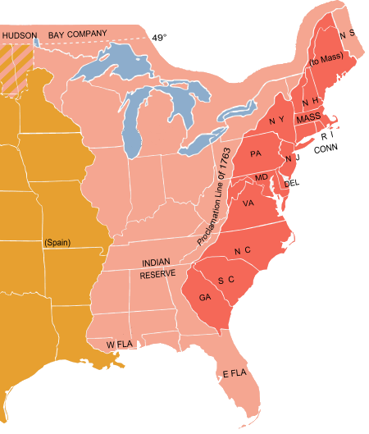
Problems after the War
-Indians in the Ohio Valley revolt against British forts
-conflicts were becoming costly for Britain
-Proclamation of 1763
stated that colonists could not cross the Appalachian Mtns
-Colonists ignored the law and continued to provoke Indians

Slide 7
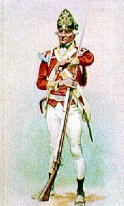
Tensions Build
-British heavily in debt because of war
-standing British Army in the colonies (remember Salutary Neglect)
-Trading restrictions established to levy duties (taxes) on certain products
- Colonist forced to in essence pay for the war with new taxes
-smugglers avoid paying taxes

Slide 8
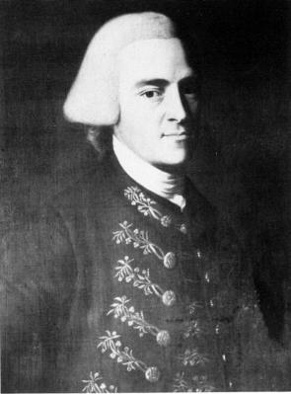
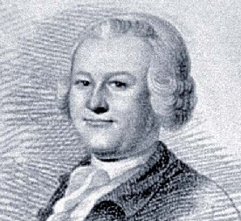
Tensions Build
-writs of assistance – 1767. Gave British right to search and take colonial property at will
-Sugar Act - affected merchants and traders First law passed by Parliament that raised tax revenues in the colonies for the crown. It increased duty on foreign sugar imported from the West Indies.
-protests began against taxation without representation
James Otis - a young lawyer in Boston, argued that colonists should not be taxed by Parliament because they could not vote for members of Parliamen

Slide 9
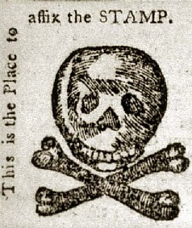
Stamp Act
-Parliament passes Stamp Act
-placed a direct tax on the colonists
-required stamp on all legal documents, newspapers, license, and cards
-affected many colonists rich and poor
-Quartering Act, 1765

Slide 10
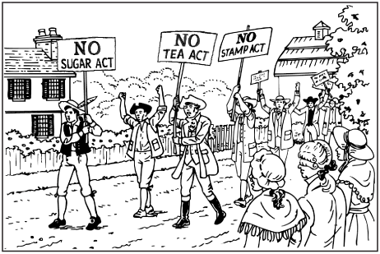
Stamp Act
-Parliament passes Stamp Act
-placed a direct tax on the colonists
-required stamp on all legal documents, newspapers, license, and cards
-affected many colonists rich and poor
-Quartering Act, 1765 – colonists must provide housing to British soldiers at anytime

Slide 11
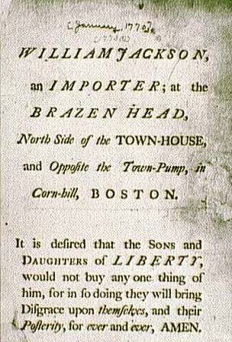
Resistance
-Sons of Liberty
Boston
Samuel Adams
John Adams
-no taxation w/o representation
-protests and boycotts were organized
-stamp agents were harassed
-law eventually repealed

Slide 12
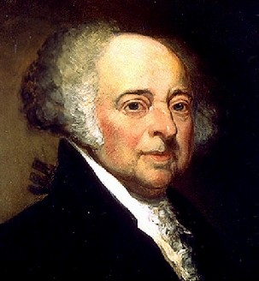
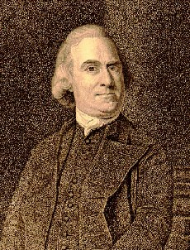
Resistance
-Sons of Liberty
Boston
Samuel Adams
John Adams
-no taxation w/o representation
-protests and boycotts were organized
-stamp agents were harassed
-law eventually repealed

Slide 13
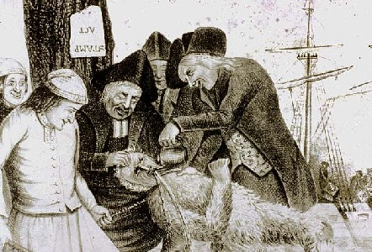
Resistance
-Sons of Liberty
Boston
Samuel Adams
John Adams
-no taxation w/o representation
-protests and boycotts were organized
-stamp agents were harassed
-law eventually repealed

Slide 14
Townshend Acts
-new tax placed on imports such as tea, glass, paper, paint
-colonists again reacted with protests
-British reacted by sending more troops

Slide 15
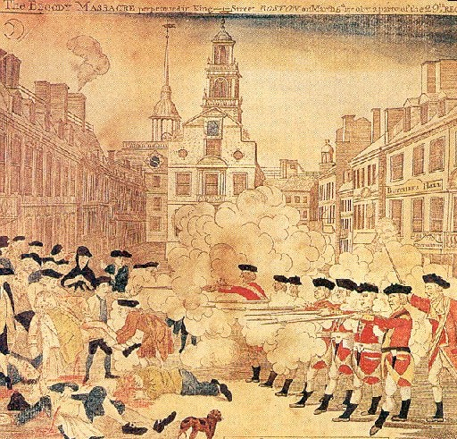
Boston Massacre
-March 1770
-protests by colonists
-British troops fire on crowd
-5 colonists killed
Crispus Attucks
-Most soldiers found not guilty
John Adams served as attorney for the soldiers

