Slide 1
On Notecard you picked up:
Write your full name and the name you would like to go by
Where would you prefer to sit?
Do you have any testing accommodations I need to know about?
Anything specific I need to know about you?
What is your favorite subject?

Slide 2
Colonization Begins

Slide 3
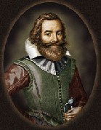
English Settlements
-Virginia Company – joint stock company
Jamestown, 1607 – inexperienced workers; wealthy; stole from Indians; all men at first.
John Smith – “Work or You Don’t Eat” – saved colony. Forced “rich, privileged” men to work
Hard times – famine, fights with Indians, disease
Powhatan – Virginia Algonquians (Pochantas)
“Starving Time”

Slide 4
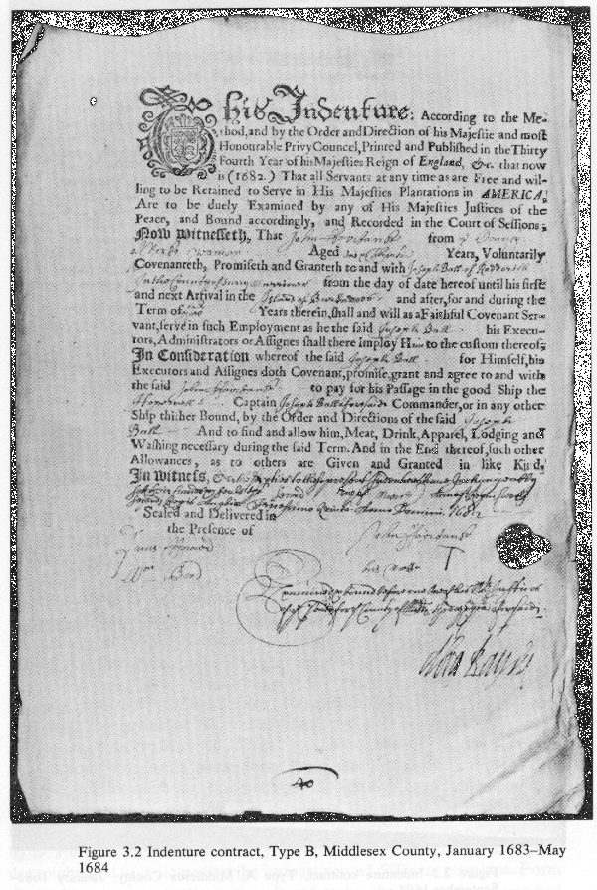
Jamestown
-more colonists – Why are they leaving England? – religious reasons, wealth, land, gold, etc.
-1st democratic gov’t
House of Burgesses – 1st step towards organized democratic government in Americas (1619)
-tobacco as a cash crop
John Rolfe
Pocahontas marriage creates temporary peace
-headright system
50 acres to each new colonist
-indentured servants
-first slaves imported (1617)
Indentured Servants were given voyage from England in return for 4-7 years of unpaid servitude.

Slide 5
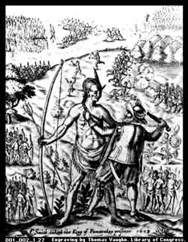
Clash with Indians
-desire for land led to conflicts
-European feelings of superiority
-no intermarriage with Indians groups
-fought wars with Powhatan Indians (3 major)
-Virginia becomes royal colony so that King’s Army can protect settlers

Slide 6
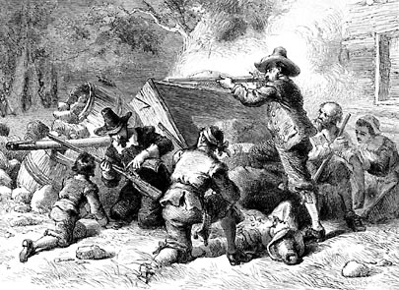
First Rebellion
-Indian dispute on the frontier
-Colonists ask for protection from Virginia Gov’t, but were denied – (William Berkley led gov’t– corrupt)
-Nathaniel Bacon led the frontier colonists in a rebellion against the Virginia gov’t and rid colony of all Indians – most rebellion colonists were former indentured servants who felt the land was rightfully theirs.
-showed signs of discontent with leadership
Bacon’s led rebellion ran Berkeley out of Jamestown and they burned down the capital. Bacon led Virginia for short while until British sent troops and hung 23 of Bacon’s supporters. (Bacon died of illness)

Slide 7
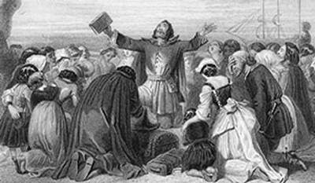
Religious Reasons
-Henry VIII begins the Anglican Church
-Reformers want to rid the church of all Roman Catholic traditions
-Puritans (Calvinists in England)
wanted to purify the Church of England – would not adapt to Henry’s changes so they left for the new world
individual and congregational control of religion

Slide 8
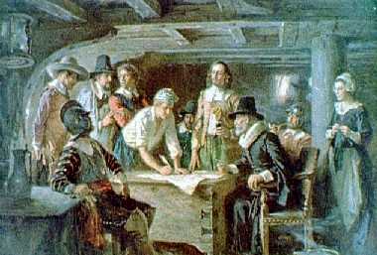
Pilgrims
-Pilgrims also called Separatists because they wanted to practice their own religion
-Plymouth Mass. 1620
-**Mayflower Compact**
set up direct democracy for the colony (blue print)
-colony struggled but received Indian help to grow crops
Thanksgiving
Squanto
-William Bradford – strict Puritan
Pilgrim leader
“Of Plymouth Plantation”

Slide 9
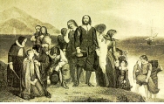
Pilgrims
-Pilgrims also called Separatists because they wanted to practice their own religion
-Plymouth Mass. 1620
-Mayflower Compact
set up direct democracy for the colony
-colony struggled but received Indian help to grow crops
Thanksgiving
Squanto
-William Bradford
Pilgrim leader
“Of Plymouth Plantation”

Slide 10
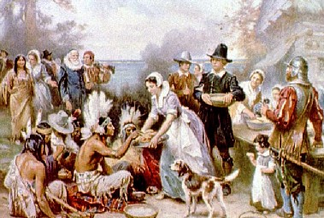
Pilgrims
-Pilgrims also called Separatists because they wanted to practice their own religion
-Plymouth Mass. 1620
-Mayflower Compact
set up direct democracy for the colony
-colony struggled but received Indian help to grow crops
Thanksgiving
Squanto
-William Bradford
Pilgrim leader
“Of Plymouth Plantation”

Slide 11
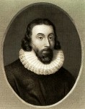
Massachusetts Bay Company
-Puritans – put good of community above the individual
-John Winthrop – leader/governor
-”City on a Hill”
be an example to the world
-connection between church and state
-strict adherence to Puritan rules – little relationship with Indians. No desire to convert them to Christianity

Slide 12
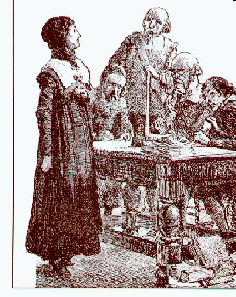
Puritan Dissent
-Roger Williams
Separation of Church and State
exiled from the colony
fled and founded Providence R.I.
-Anne Hutchinson
belief in individual worship
banished in famous trial
fled to R.I.
- ***New England Confederation – Puritan colonies Bay, Plymouth, New Haven, and scattered Connecticut. 1st attempt at colonial unity.

Slide 13
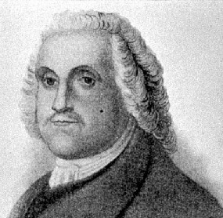
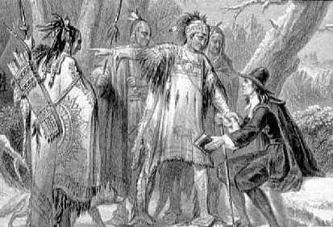
Puritan Dissent
-Roger Williams
Separation of Church and State
exiled from the colony
fled and founded Providence R.I.
-Anne Hutchinson
belief in individual worship
banished in famous trial
fled to R.I. – eventually recanted but exiled anyway. Went to Rhode Island. Later, she and her family were massacred by Indians. John Winthrop said this was result of “God’s Hand”…ouch.

Slide 14
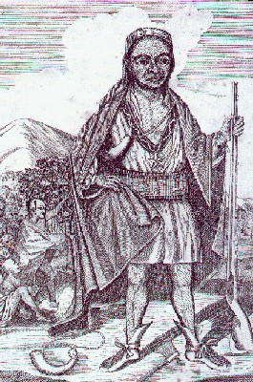
Indian Resistance
-some cooperation but short lived
-disease, land, and religion caused disputes
-Pequot War, 1637
massacre of Indians – 400 Pequot Indians killed virtually annihilating their tribe. Uneasy peace set in…
-King Philip’s War
lots of deaths on both sides but colonists win and Indian resistance fades

