Slide 1
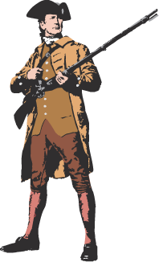
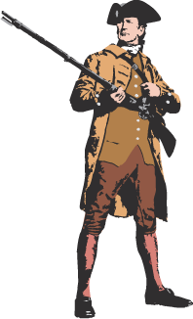
The Road
to Revolution:
(1770-1776)
APUSH

Slide 2
Was the
American Revolution
Inevitable??

Slide 3
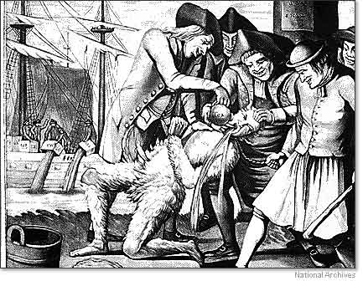
Tar and Feathering

Slide 4
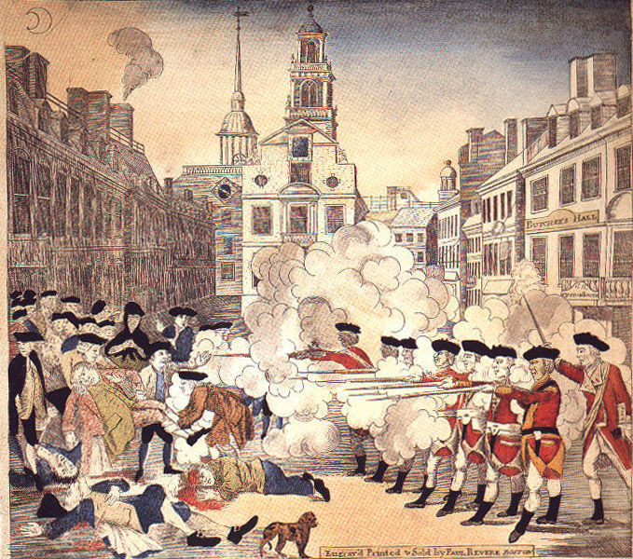
The Boston Massacre (March 5,1770)

Slide 5
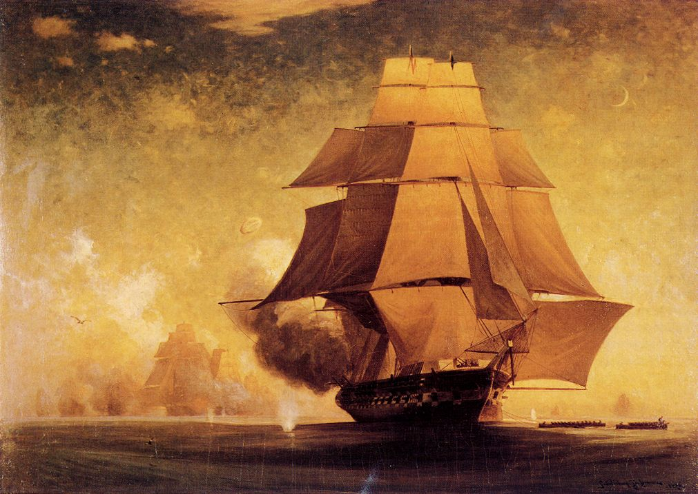
The Gaspee Incident (1772)
The colonists thought that there was a conspiracy against them. Seizing their opportunity to destroy the hated vessel, a group of colonists disguised as Native Americans ordered the British crew ashore and then set fire to the ship.
Providence, RI coast

Slide 6
Committees of Correspondence
Organized by patriot leader Samuel Adams, was a system of communication between patriot leaders in New England and throughout the colonies. They provided the organization necessary to unite the colonies in opposition to Parliament. The committees sent delegates to the First Continental Congress.
Purpose -

Slide 7
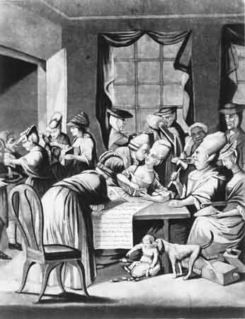
Tea Act (1773)
British East India Co.:
Monopoly on British tea imports.
Many members of Parliament held shares.
Permitted the Co. to sell tea directly to colonies without colony middlemen (cheaper tea!)
North expected the colonies to eagerly choose the cheaper tea.

Slide 8
Tea Act (1773)
however colonists felt that it broadsided colonial merchants and smugglers and was an effort to garner support for previous taxes

Slide 9
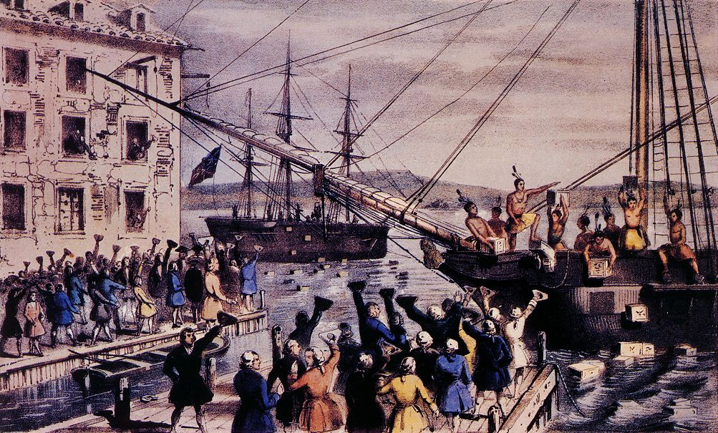
Boston Tea Party (1773)

Slide 10
Boston Tea Party (1773)
In a radical form of defiance, on December 16, 1773, sixteen men dressed as Mohawk Indians board three ships in Boston Harbor, carrying mainly tea, and dump their contents in the Harbor; as punishment, the Coercive Acts are installed the following June

Slide 11
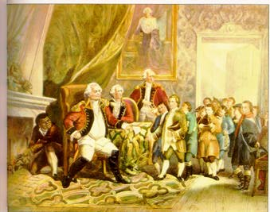
The Coercive or Intolerable Acts (1774)
Acts instituted by the British as punishment for the Boston Tea Party; closed Boston Harbor until debt could be repaid, dissolved all town meetings in MA, and appointed British as all government officials
Lord North

Slide 12
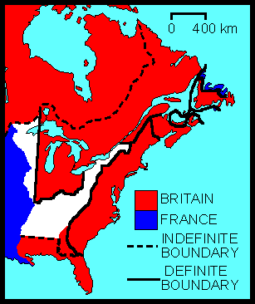
The Quebec Act (1774)
Aid out the way in which the providence of Quebec was to be governed; included in the Coercive Acts, it displeased many

Slide 13
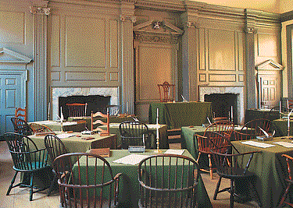
First Continental Congress (1774)
55 delegates from 12 colonies
Gathering of delegates from 12 of the 13 colonies in; discussed action to be carried out in response to the Coercive (Intolerable) Acts, adopted a Declaration of American Rights, urged MA to arm for defense, adopted the Continental Association to boycott British goods

Slide 14
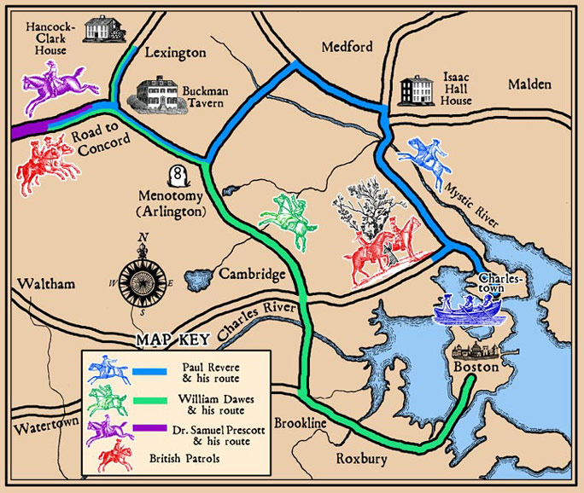
The British Are Coming . . .
Paul Revere & William Dawes make their midnight ride to warn the Minutemen of approaching British soldiers.

Slide 15
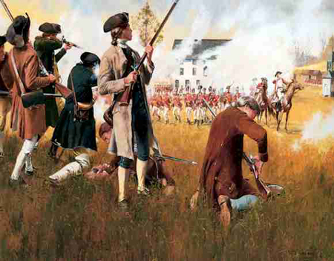
The Shot Heard ’Round the World!
Lexington & Concord – April 18,1775

Slide 16
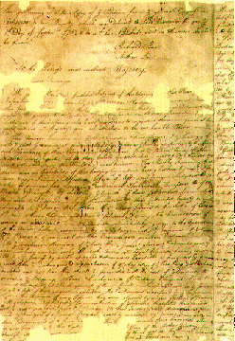
The Second Continental Congress (1775)
met following the First Continental Conference to begin regulating the war effort and to adopt the Declaration of Independence, put together by Thomas Jefferson, to be sent to George III
Olive Branch Petition
Last stand, so to speak, by the Americans in an effort to settle disputes with the British in a peaceful fashion (if you listen to us we'll listen to you); King scoffed at it and wouldn't even look at the petition

Slide 17
Was the
American Revolution
Inevitable??

Slide 18
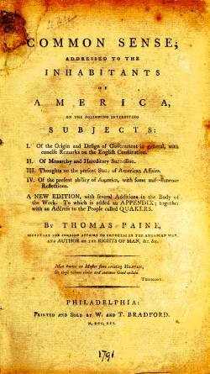
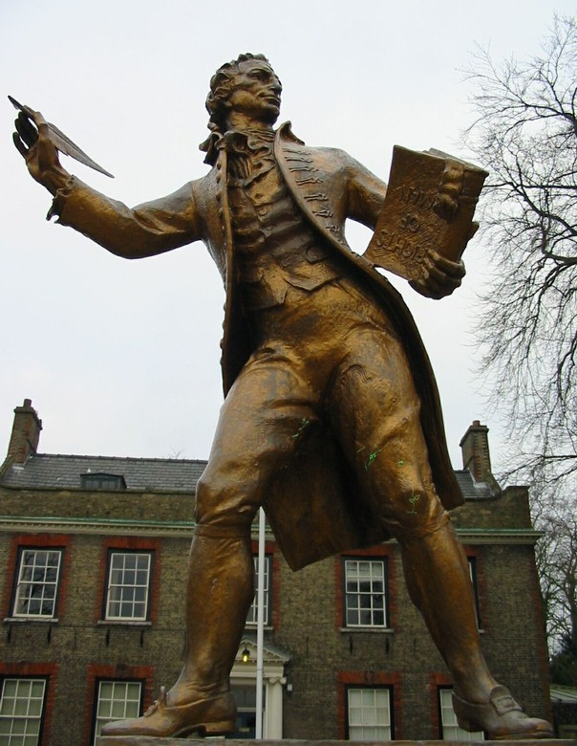
Thomas Paine: Common Sense

Slide 19
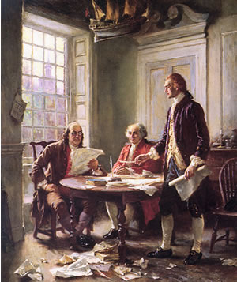
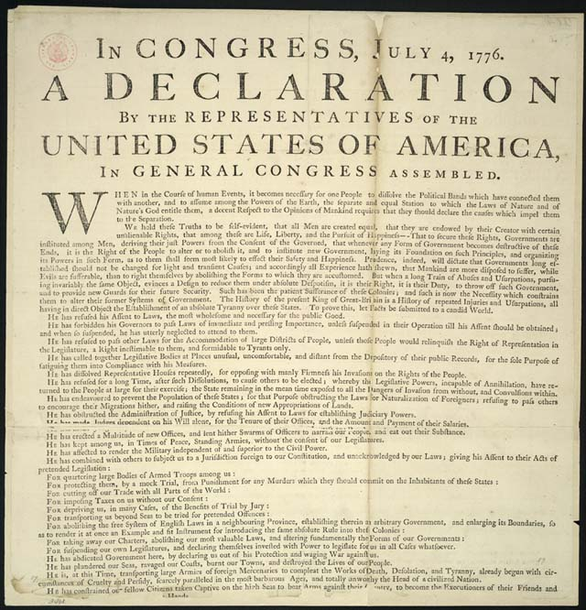
Declaration of Independence (1776)

Slide 20
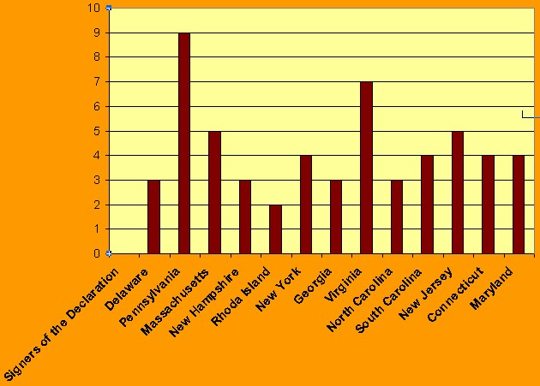
Declaration of Independence

Slide 21
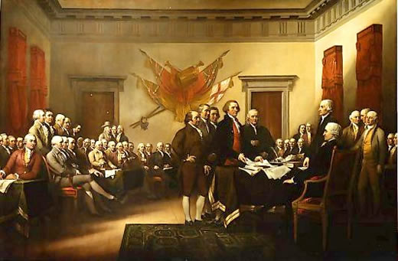
Independence Hall

Slide 22
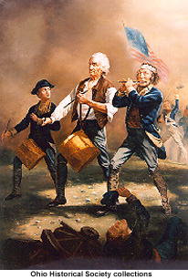
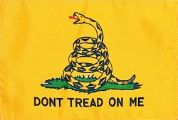
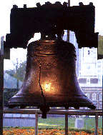
New National Symbols

