Slide 1
Essential Question:
What were the various plans to bring Southern states back into the Union and to protect newly-emancipated slaves?

Slide 2
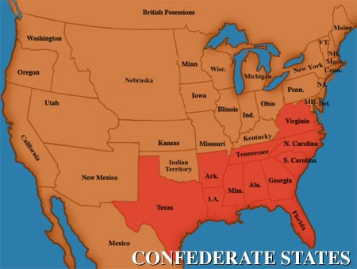
Reconstruction is the era from 1865 to 1877 when the U.S. government attempted to rebuild the nation after the Civil War
During Reconstruction, the government had to readmit the seceded Southern states back into the Union
Quick Class Discussion: What were the three goals of the federal government during Reconstruction?
End slavery and protect newly emancipated slaves
Rebuilt the South after more than four years of fighting
Reconstruction Video

Slide 3
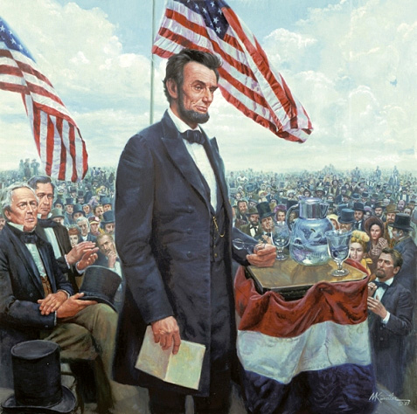
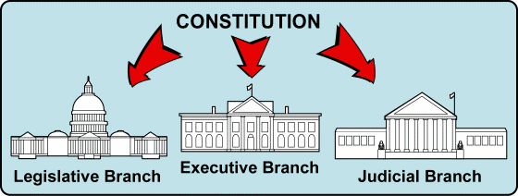
As the Civil War was ending, President Lincoln promised a Reconstruction Plan for the Union with “malice towards none and charity for all”
But, the Constitution gave no guidelines on how to readmit states to the Union
The President and Congress disagreed over how to treat the Southern states
Abraham Lincoln’s Second Inaugural Address

Slide 4
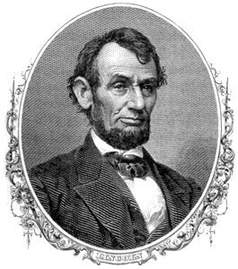
Lincoln favored a plan that would quickly re-admit the Confederate states once 10% of the people swore an oath of loyalty and states ratified the 13th Amendment to abolish slavery in America

Slide 5
“Radical Republicans” in Congress rejected Lincoln’s plan because it was too lenient on ex-Confederates
They favored a plan that protected blacks, required 50% of state citizens to swear a loyalty oath, and banned ex-Confederate leaders from serving in gov’t
When the Civil War ended and Lincoln was assassinated, the government did not have a Reconstruction Plan in place

Slide 6
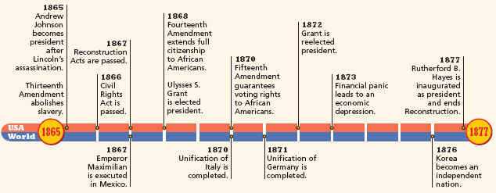
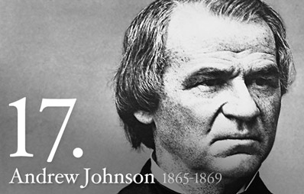
Reconstruction: 1865-1877
After Lincoln was assassinated in 1865, VP Andrew Johnson created a plan known as Presidential Reconstruction (1865-1867)
Johnson’s plan was lenient on Confederate states because he wanted the South to rejoin the United States quickly

Slide 7
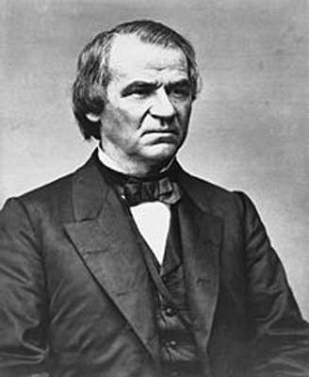
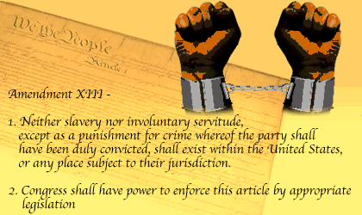
Presidential Reconstruction
Ex-Confederate states could rejoin the USA once they ratified the 13th Amendment

Slide 8
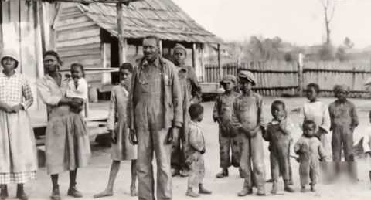
Presidential Reconstruction did not require Southern state governments to protect former slaves
Southern states passed black codes to keep African Americans from gaining land, jobs, and protection under the law

Slide 9
Reconstruction: 1865-1877
“Radical Republicans” in Congress led by Thaddeus Stevens opposed Johnson’s Reconstruction plan and pushed for laws to protect blacks
Thaddeus Stevens

Slide 10
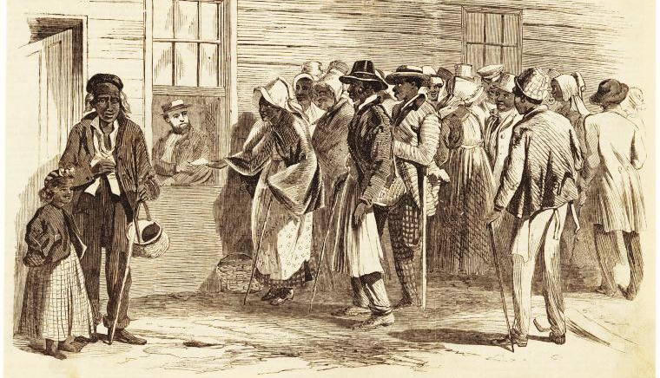
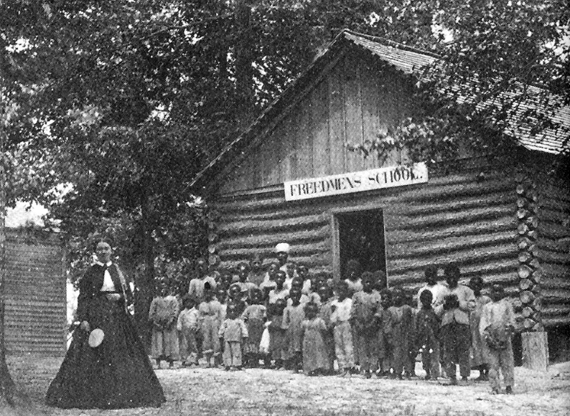
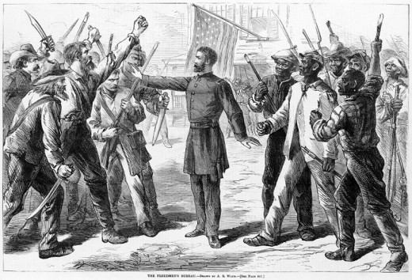
In 1865, Congress created the Freedman’s Bureau to help former slaves
The Bureau provided emergency food, housing, and medical supplies
Promised former slaves “40 acres and a mule” but never delivered
Agents went supervised labor contracts
Its most important legacy of the Freedman’s Bureau was the creation of new schools

Slide 11
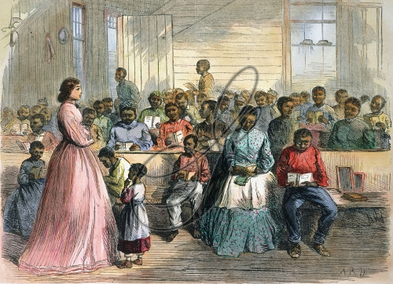
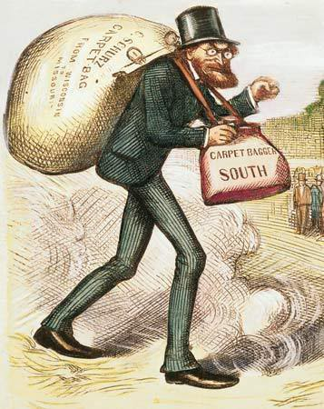
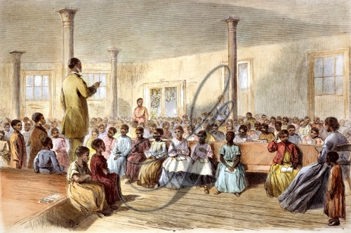
Former abolitionists and profiteers moved South were called “carpetbaggers”

Slide 12
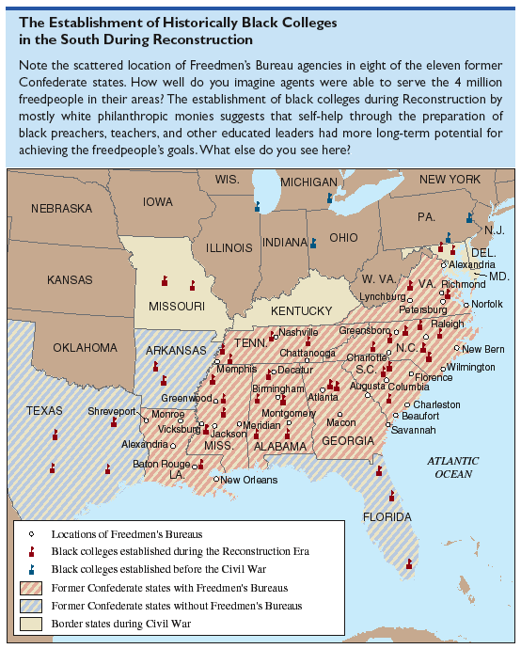
Freedmen’s Bureaus and Black Colleges in the South
The emphasis on education led to the creation of black universities, such as Morehouse College in Atlanta

Slide 13
Reconstruction: 1865-1877
Even with the Freedman’s Bureau, Radical Republicans feared that Johnson’s lenient Reconstruction Plan would violate blacks’ civil rights
Congress drafted the 14th Amendment that included former slaves as citizens and guaranteed all citizens equal protection under the law

Slide 14
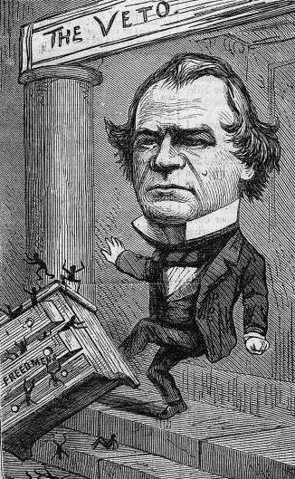
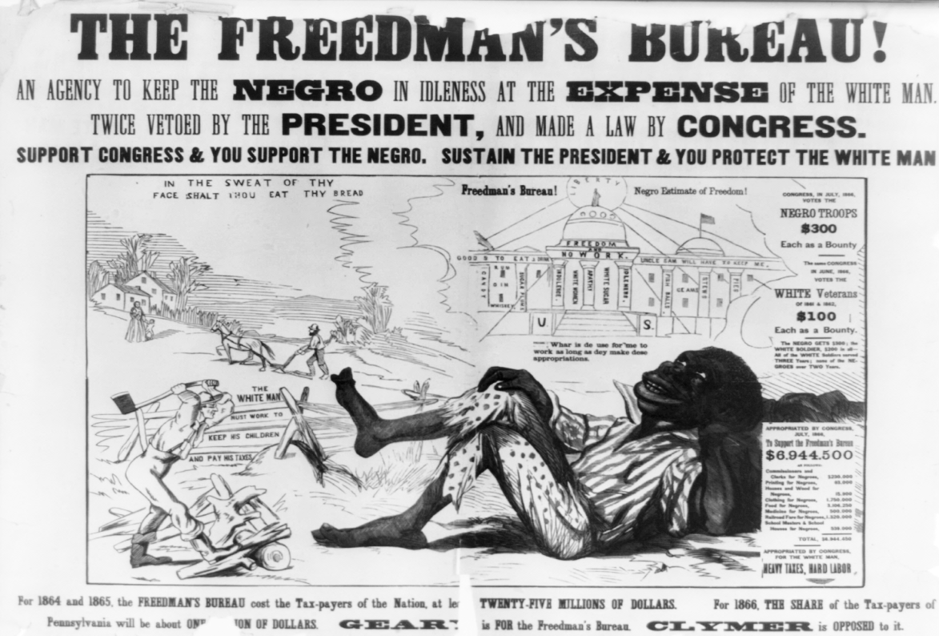
President Johnson thought that these new protections would anger Southerners and slow down Reconstruction
Johnson opposed the Freedman’s Bureau and tried to convince states not to ratify the 14th Amendment
By 1867, moderate and radical Republicans realized that they needed to take control of Reconstruction from the president

Slide 15
Reconstruction: 1865-1877
Radical Republicans in Congress created their own plan called Congressional Reconstruction (1867-1877)
Congressional Reconstruction was strict, protected the rights of former slaves, and kept Confederate leaders from regaining power in the South

Slide 16
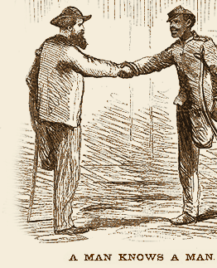
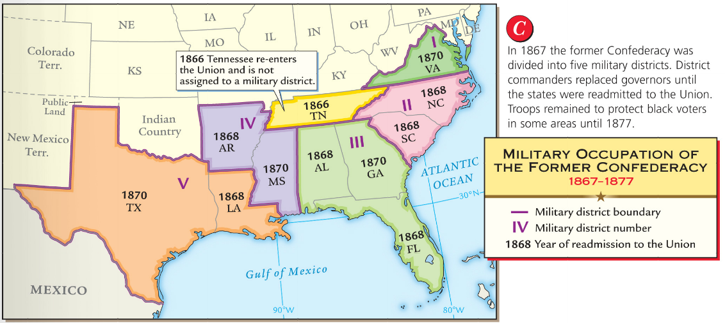
Congress passed the Reconstruction Act of 1867
The South was divided into 5 military zones with US troops to enforce Reconstruction
Ex-Confederate states were required to give black men the right to vote at the state level
To be readmitted, states had to ratify the 14th Amendment protecting black citizenship

Slide 17
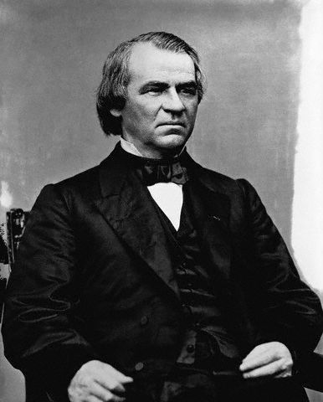
Reconstruction: 1865-1877
President Johnson obstructed Congressional Reconstruction by firing military generals appointed by Congress to oversee Southern military zones
He violated a new law called the Tenure of Office Act when he tried to fire his Secretary of War who supported Congress’ plan

Slide 18
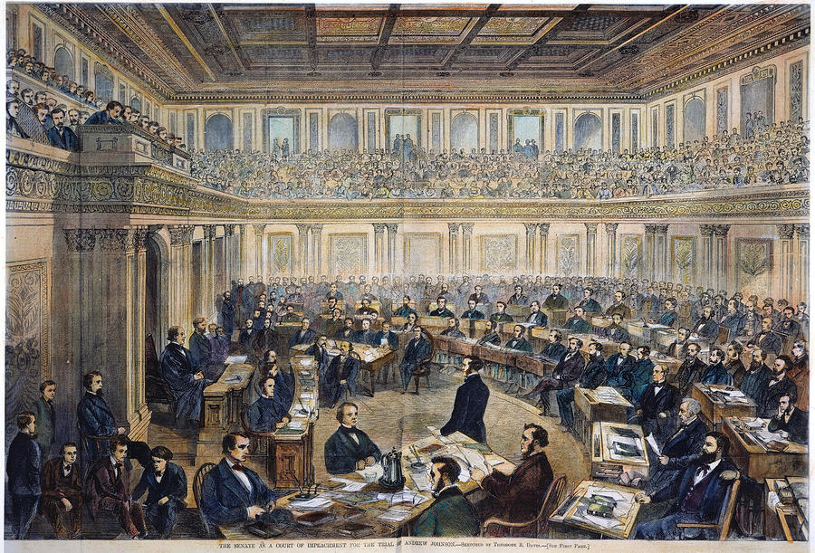
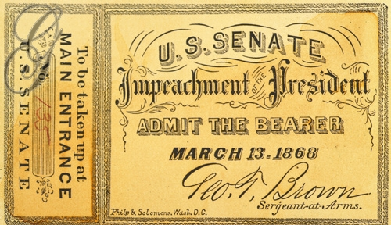
Radical Republicans used this as an opportunity to impeach the president
The House of Representatives voted 126-47 to charge Johnson with a crime
After an 11 week trial, the Senate fell 1 vote short of removing the president from office
Johnson successfully argued that he had not committed a “high crime or misdemeanor”

Slide 19
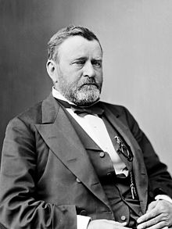
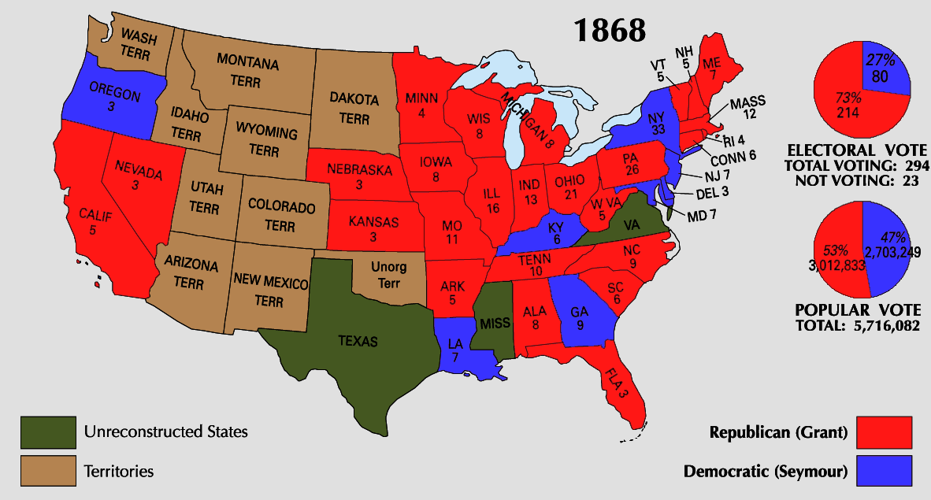
In 1868, Civil War hero Ulysses Grant won the presidency as a Republican candidate
President Grant (1869-1877) worked with Congress to enforce Reconstruction
By 1870, all the ex-Confederate states were readmitted to the United States

Slide 20
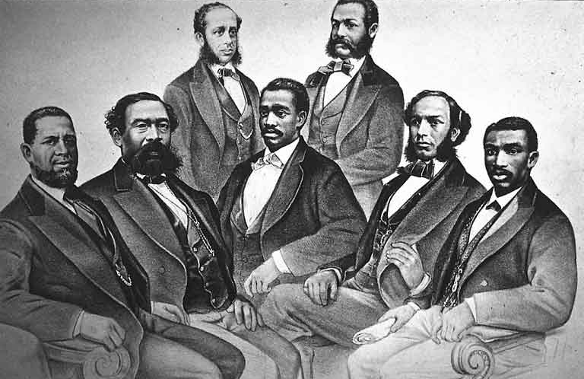
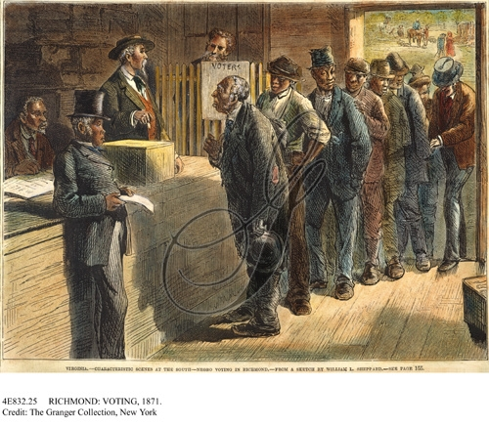
During Congressional Reconstruction, African Americans experienced unprecedented rights
The 15th Amendment gave black men the right to vote in 1870
The 1st black politicians were elected to state and national offices

Slide 21
During Congressional Reconstruction, African Americans experienced unprecedented rights
Literacy and education increased among blacks
Black families were reunited, marriages were legally recognized, and black workers could make their own money

Slide 22
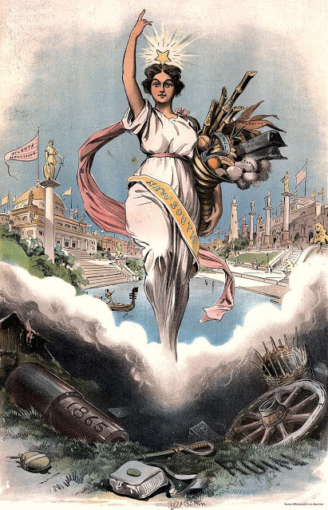
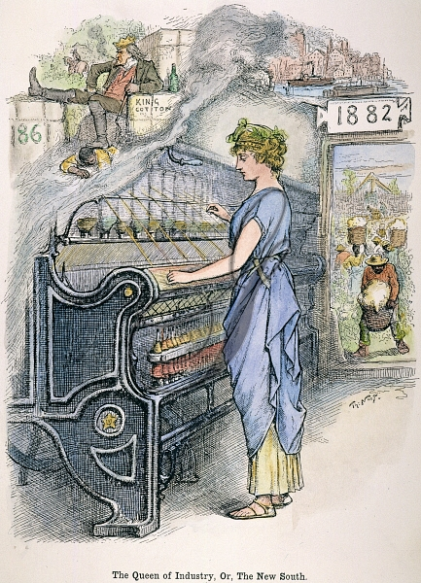
Reconstruction brought economic changes to the South
After the Civil War, the Southern economy became more diverse with new iron, steel, and textile mills
The new industrial economy required hired workers
The government built railroads and helped repair the South

Slide 23
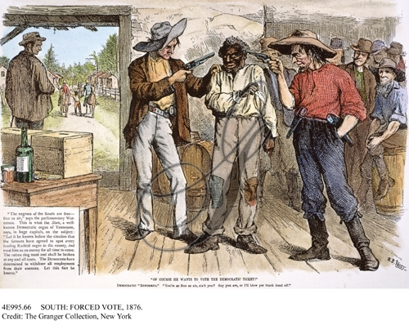
Based upon the image below, what were the major failures of Reconstruction?
“Of course he wants to vote for the Democratic ticket”

Slide 24
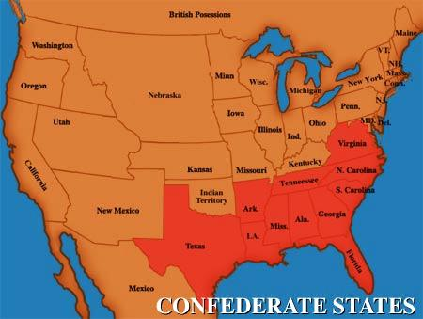
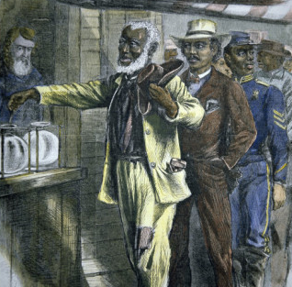
During Reconstruction, all eleven Southern states were re-admitted into the Union
The 13th, 14th, and 15th Amendments guaranteed rights and equality for blacks in the South

Slide 25
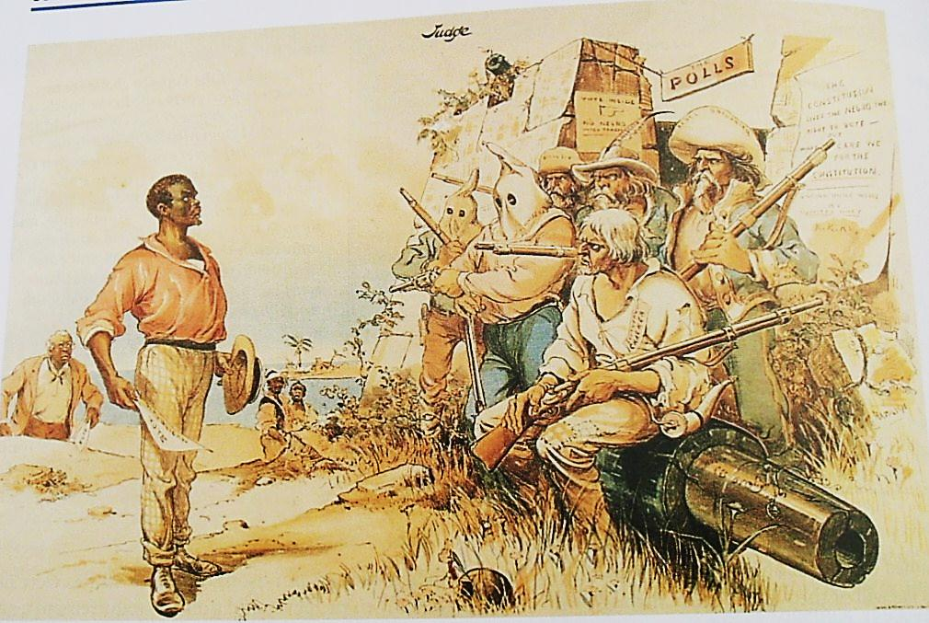
But, Reconstruction was difficult to maintain as Democrats slowly took back control of Southern states
Listen to the song “Good Ole Rebel” and write down 3 words or phrases that describe Southern white attitudes towards Reconstruction

Slide 26
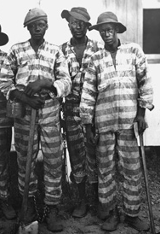
Southern governments resisted Reconstruction by passing more discriminatory black codes
Black codes restricted blacks from serving on juries, testifying against whites in court, marrying whites, or owning land
These laws often restricted black workers from gaining skilled jobs or competing against white workers
Black men could be forced into slavery as punishment for a crime or for not paying back debts

Slide 27
The Supreme Court ruled against civil rights laws designed to protect African-Americans

Slide 28
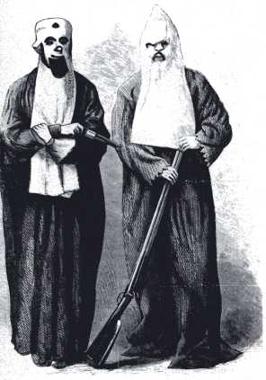
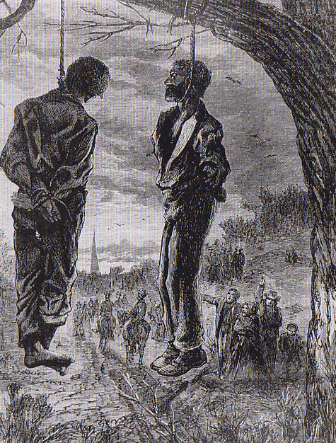
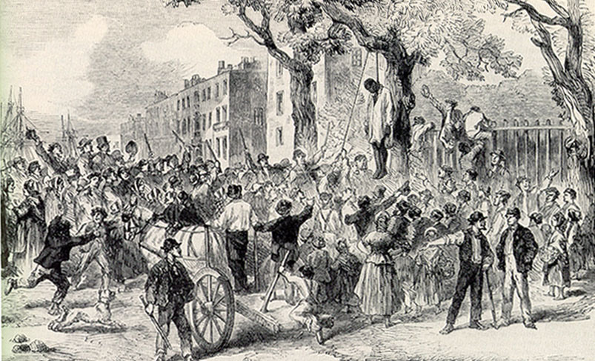
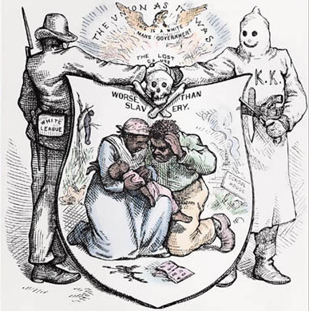
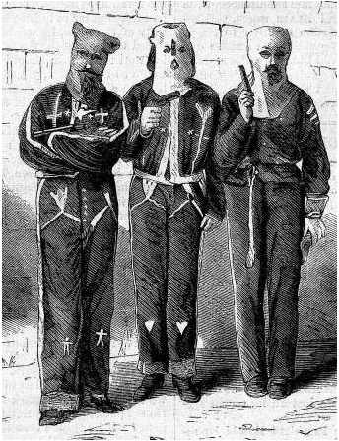
Southerners used violence and intimidation to keep blacks inferior to whites
The Ku Klux Klan was first formed during Reconstruction to attack blacks who tried to vote or challenge white supremacy
Lynching became more common

Slide 29
Southerners supported the return of the Democratic Party to state governments
Black codes and the KKK successfully limited black voting
Federal troops in Southern military districts had difficulty protecting blacks

Slide 30
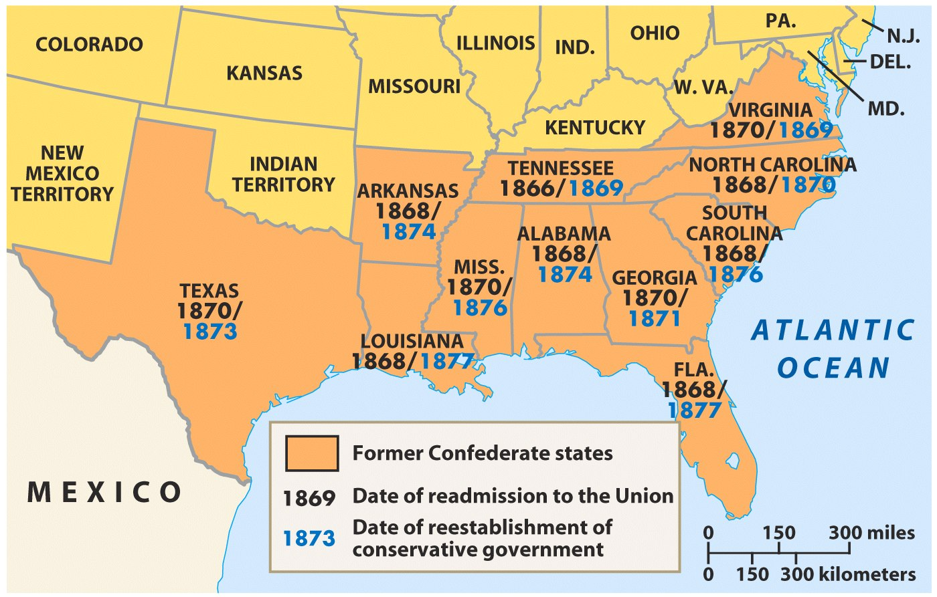
One-by-one, Southern state governments shifted from Republican control to the Democratic Party
Notes:
By 1876, only SC, FL, & LA were controlled by Republicans

Slide 31
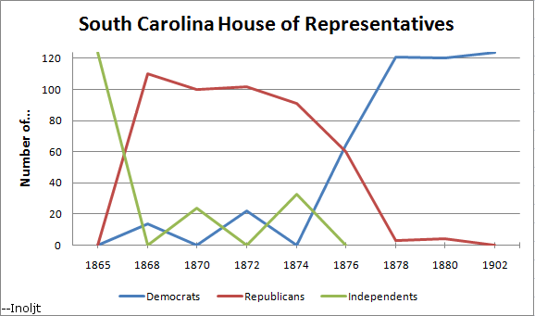
These “Redeemer Democrats” hoped to restore the “Old South”

Slide 32
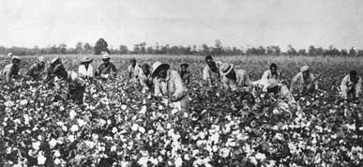
The Civil War ended slavery, but African-Americans had little job training or money for farm land
With few other options, most ex-slaves returned to the plantation to work

Slide 33
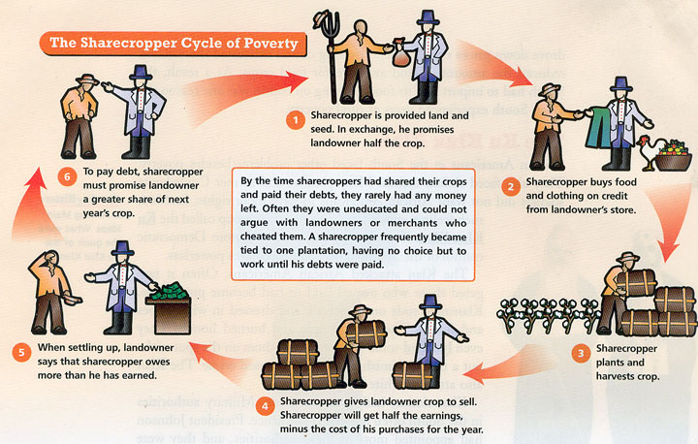
After the Civil War, slavery was replaced by sharecropping, also known as the tenant farming

Slide 34
White land owners would rent parcels of their fields to blacks in exchange for ½ to ¼ of the cotton they produced

Slide 35
But, tenants had no money for tools or seeds so they gained loans from the land owner in exchange for more of their cotton (crop lien system)

Slide 36
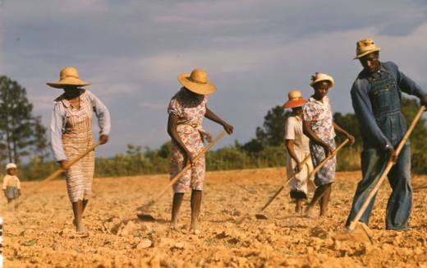
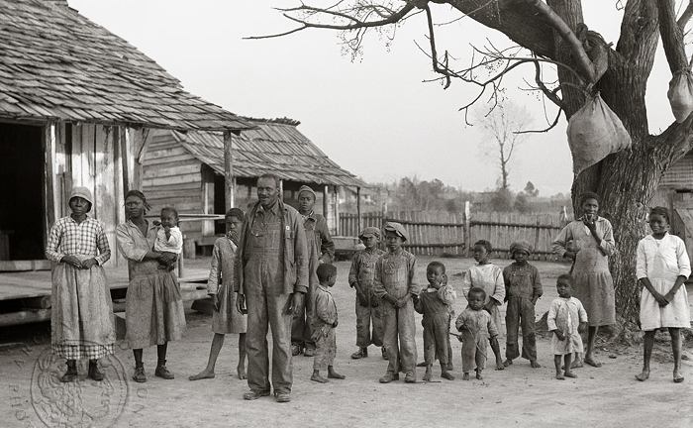
By the end of 1865, most freedmen had returned to work on the same plantations on which they were previously enslaved
Sharecropping remained in place until the 1940s

Slide 37
By the mid-1870s, the Democratic Party returned to power in most Southern states
The only thing protecting blacks were federal troops

Slide 38
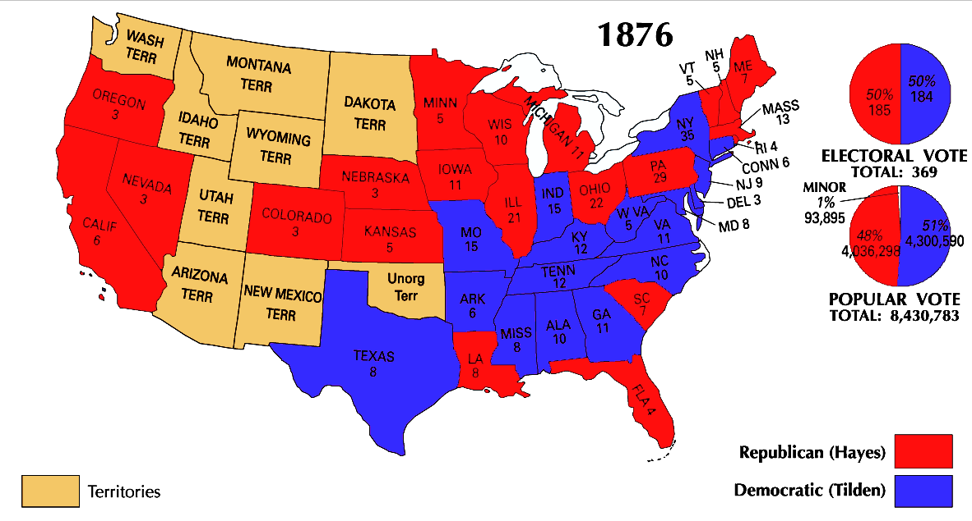
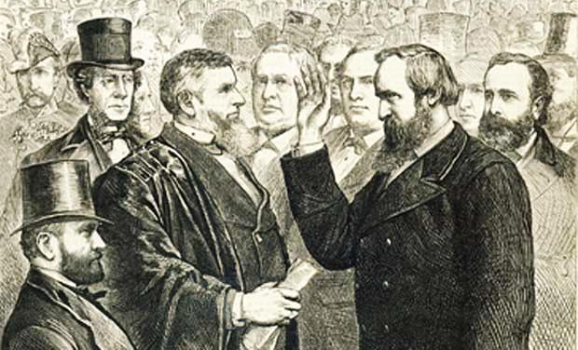
In the 1876 election, neither Democrat Tilden nor Republican Hayes won a majority of electoral vote
Republicans and Democrats in Congress agreed to the “Compromise of 1877” in which Democrats agreed to vote for Hayes as president if federal troops were removed from the South

Slide 39
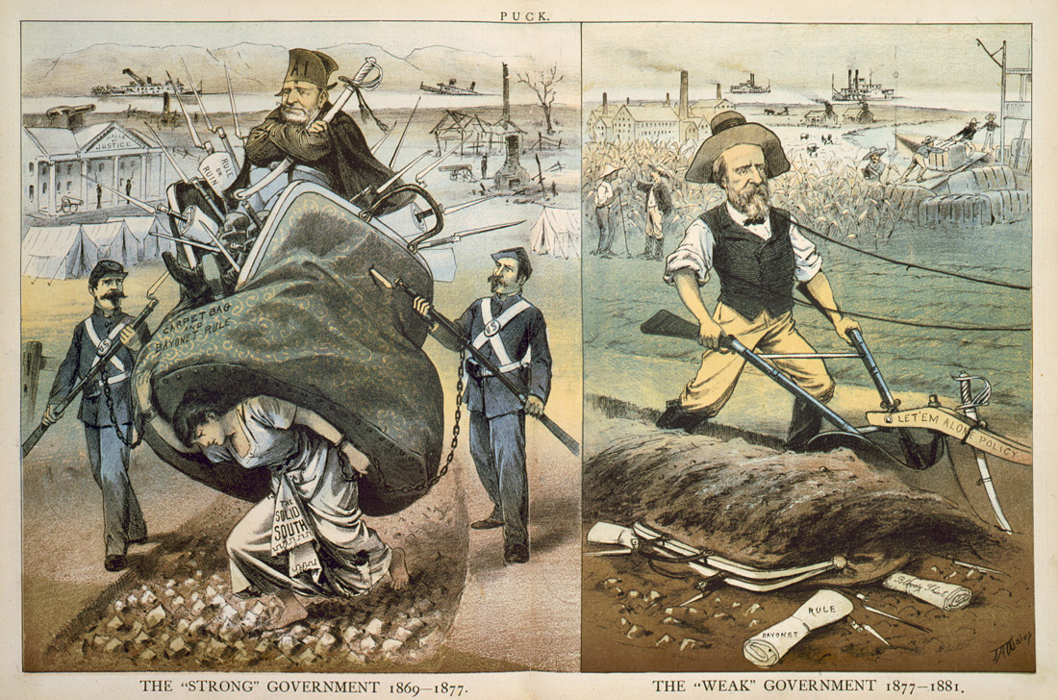
When President Hayes removed federal troops in 1877, Reconstruction officially ended

Slide 40
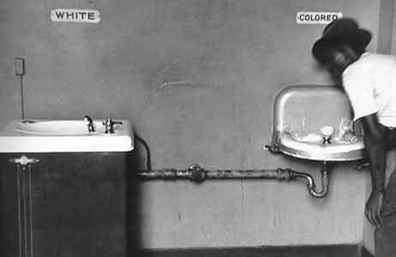
When Reconstruction ended, the Jim Crow era began (1877-1954)
Jim Crow laws segregated Southern society and restricted blacks from voting with poll taxes and literacy tests

Slide 41
Group Activity: Grading Reconstruction Plans

