Slide 1
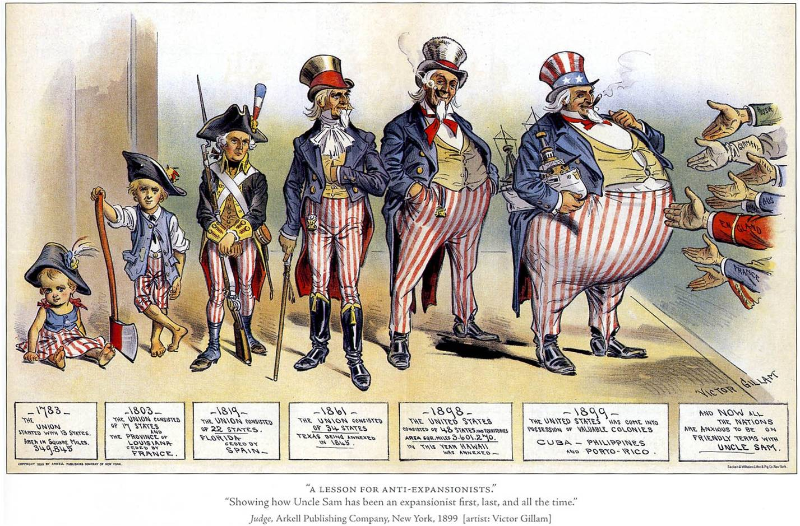
Essential Question:
How did America’s role in the world change from 1890 to 1914?
CPUSH Agenda for Unit 9.1:
Clicker Preview Questions
American Imperialism notes
Today’s HW: 18.1 and 18.2
Unit 9 Test: Thursday, January 17
American Imperialism

Slide 2
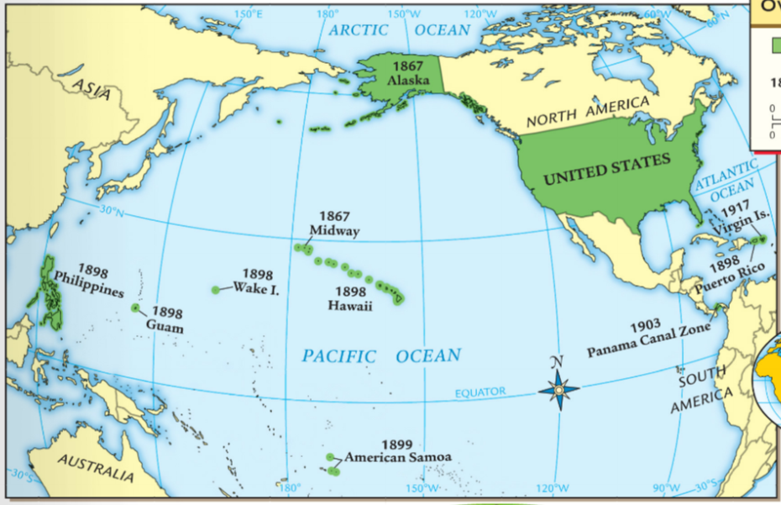
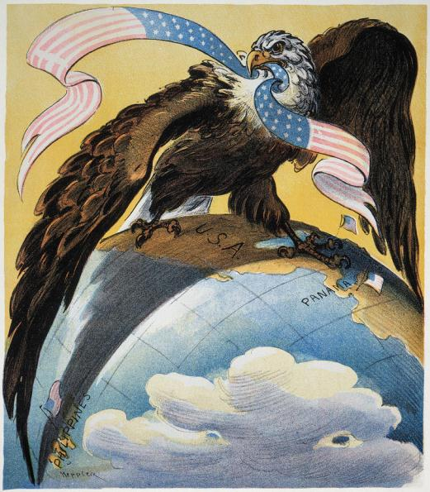
From 1890 to 1914, the United States expanded its role in world affairs and gained new overseas colonies
Class Activity: Use the HAPI Template Was this a radical shift from previous U.S. foreign policy? Use the following documents to explain America’s role in the world from 1790 to 1900

Slide 3
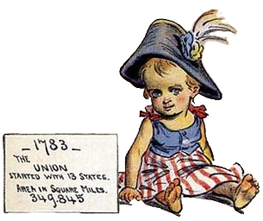
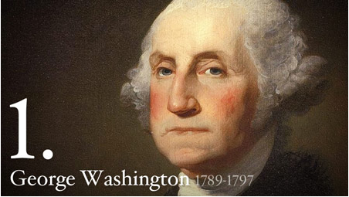
“The Great rule of conduct for [the U.S.], in regard to foreign Nations is in extending our commercial relations to have with them as little political connection as possible... 'Tis our true policy to steer clear of permanent alliances, with any portion of the foreign world”
—George Washington, Farewell Address (1796)

Slide 4
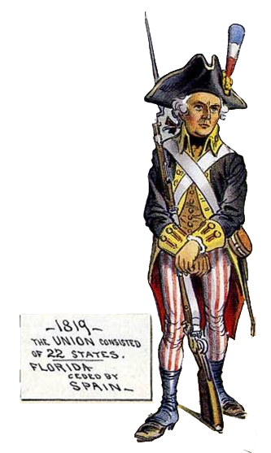
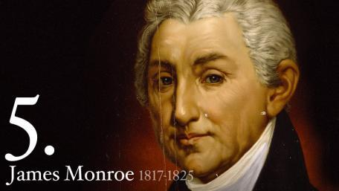
“The American continents…are henceforth not to be considered as subjects for future colonization by any European powers. We should consider any attempt on their part to extend their system to any portion of this hemisphere as dangerous to our peace and safety”
—The Monroe Doctrine (1823)

Slide 5
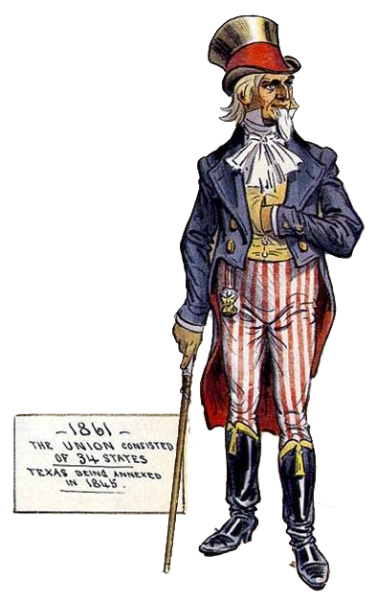
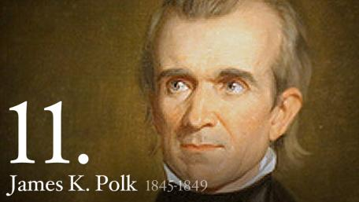
“The American claim is by the right of our manifest destiny to overspread and to possess the whole of the continent which Providence has given us for the development of the great experiment of liberty and federated self-government entrusted to us”
—John O’Sullivan New York Morning News (1845)

Slide 6
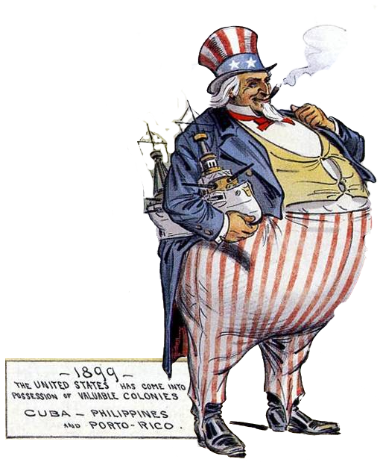
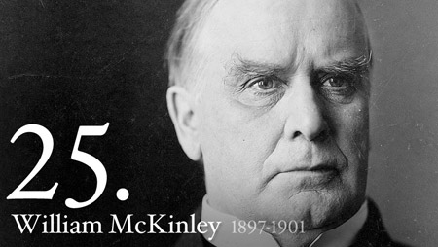
“American factories are making more than the American people can use; American soil is producing more than they can consume. Fate has written our policy for us; the trade of the world must and shall be ours.”
—Senator Albert Beveridge (1898)

Slide 7
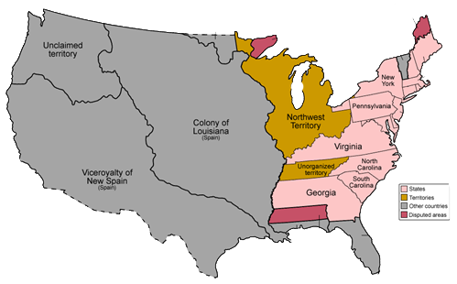
When the USA was a new nation, it was limited to 13 states in territory east of the Mississippi River…
…George Washington promoted neutrality and warned against alliances with European nations

Slide 8
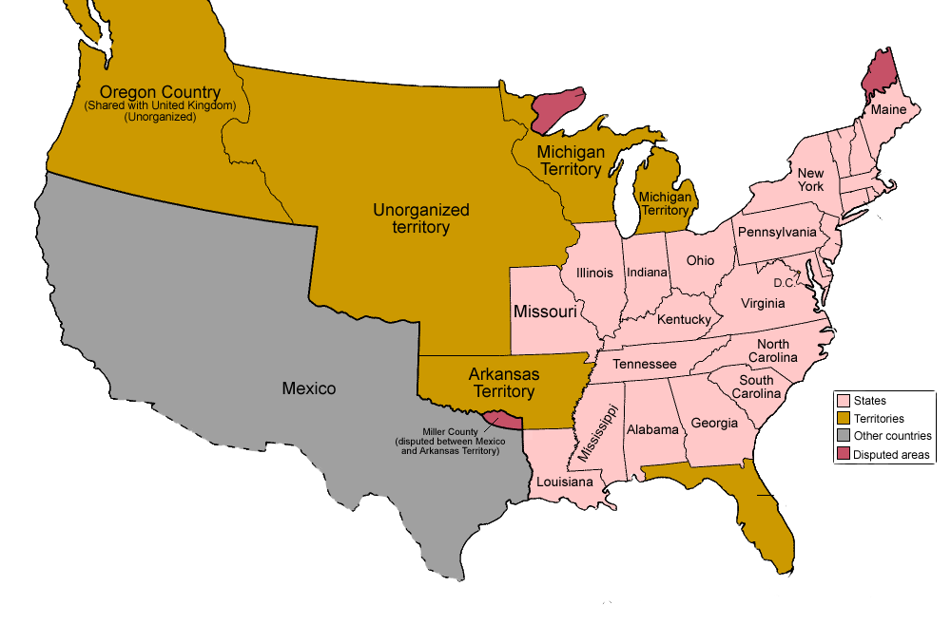
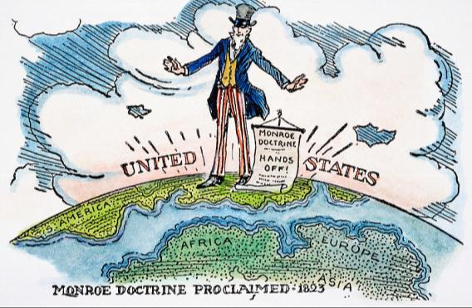
By the 1820s, the U.S. purchased Louisiana, “won” the War of 1812, gained Florida, and was no longer an infant nation…
… In 1823 President James Monroe issued the Monroe Doctrine asserting neutrality but that the U.S. would protect the western hemisphere from European influence

Slide 9
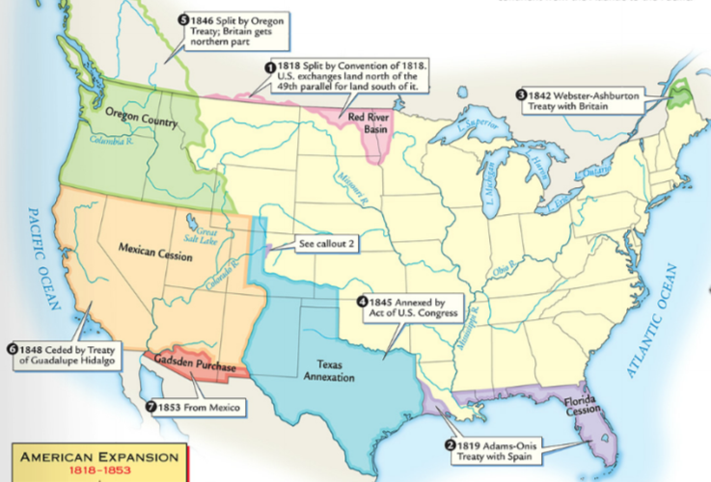
In the 1840s, President James Polk used an aggressive foreign policy (including treaties, purchases, and war with Mexico) to gain all lands to the Pacific Ocean and fulfill America’s Manifest Destiny

Slide 10
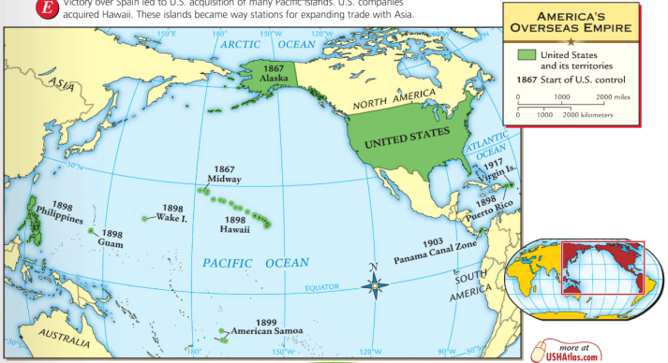
During the Gilded Age, the United States emerged as an imperial power by gaining Alaska, Hawaii, Guam, Puerto Rico, the Philippines and leading construction of the Panama Canal

Slide 11
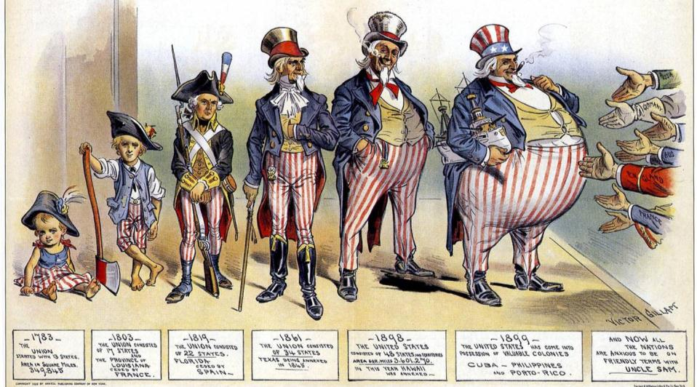
From the American Revolution to the Civil War, America gained new western territories, but remained neutral in European affairs…

Slide 12
…during the Gilded Age, the United States gained overseas territories and thought of itself as an equal power to European nations

Slide 13
Americans were motivated to imperialize for a variety of reasons during the Gilded Age
Small group discussion:
Brainstorm at least three reasons why the U.S. was motivated to expand and claim overseas colonies

Slide 14
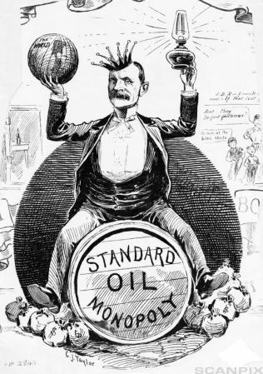
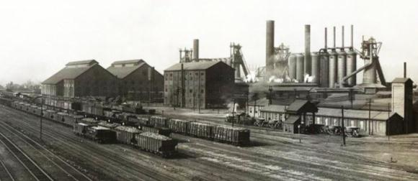
Americans were motivated to imperialize for a variety of reasons during the Gilded Age
American industry grew so large that companies needed new sources of raw materials and overseas markets to sell their products

Slide 15
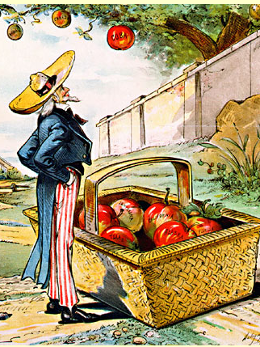
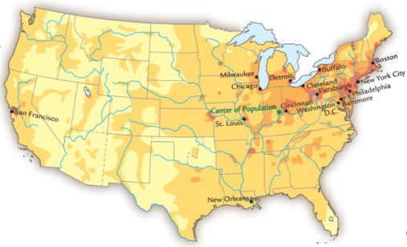
Americans were motivated to imperialize for a variety of reasons during the Gilded Age
In 1890, the U.S. census revealed that the American frontier was closed and there were no new lands in the “west” to expand into

Slide 16
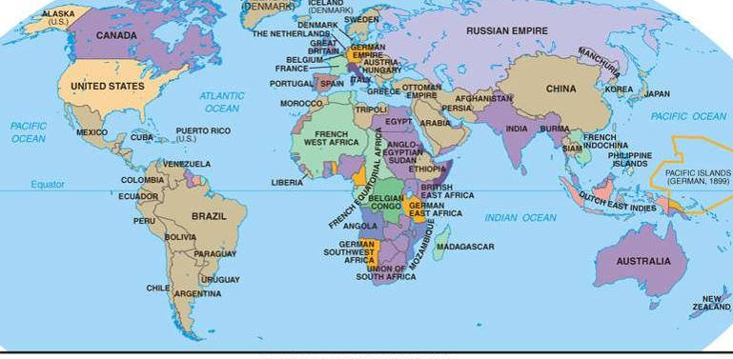
Americans were motivated to imperialize for a variety of reasons during the Gilded Age
Americans felt the need to keep up with other European imperial nations who were building colonies

Slide 17
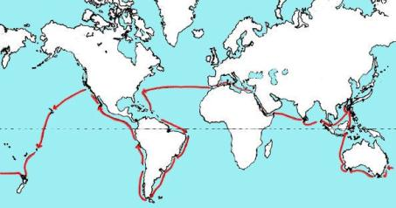
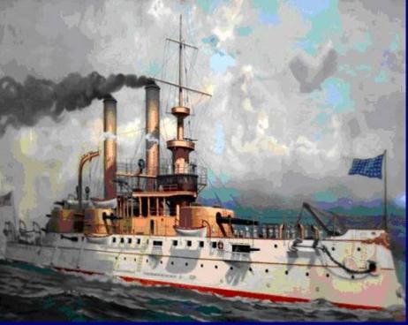
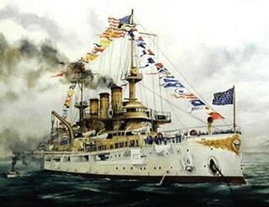
Americans were motivated to imperialize for a variety of reasons during the Gilded Age
Admiral Alfred Mahan encouraged the USA to build a modern navy so it could compete with European militaries
World tour of the “Great White Fleet”

Slide 18
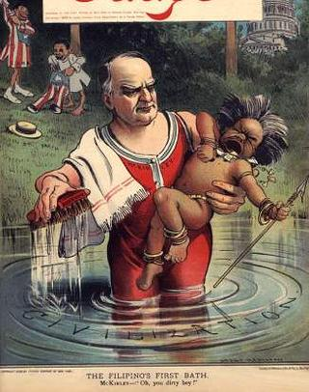
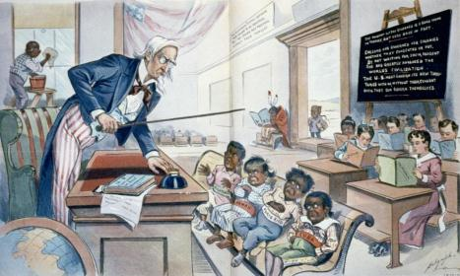
Americans were motivated to imperialize for a variety of reasons during the Gilded Age
Many believed in Social Darwinism and the responsibility to “civilize” the “inferior races” of the world by spreading technology, Christianity, and democracy…

Slide 19
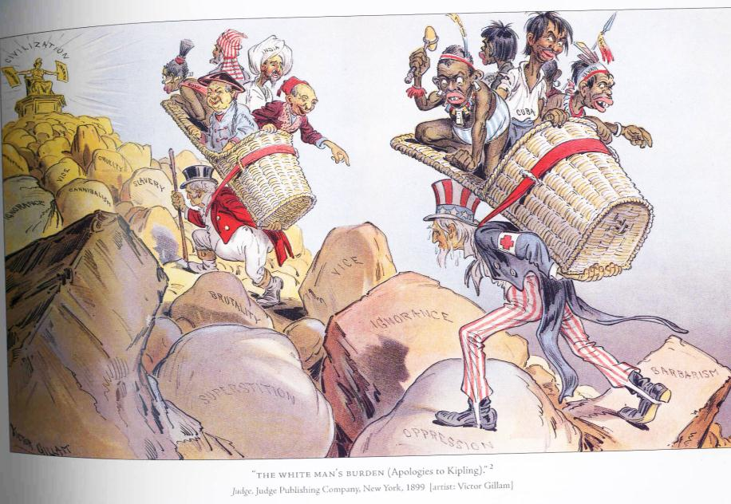
…also known as the White Man’s Burden
White Man’s Burden By Rudyard Kipling (1899)
Take up the White Man's burden-- Send forth the best ye breed-- Go bind your sons to exile To serve your captives' need; To wait in heavy harness, On fluttered folk and wild-- Your new-caught, sullen peoples, Half-devil and half-child. Take up the White Man's burden-- In patience to abide, To veil the threat of terror And check the show of pride; By open speech and simple, An hundred times made plain To seek another's profit, And work another's gain.

Slide 20
After each section of the notes, write a newspaper headline that accurately and succinctly defines America’s imperialist actions

Slide 21
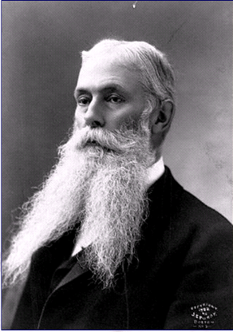
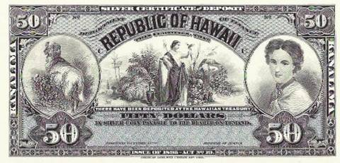
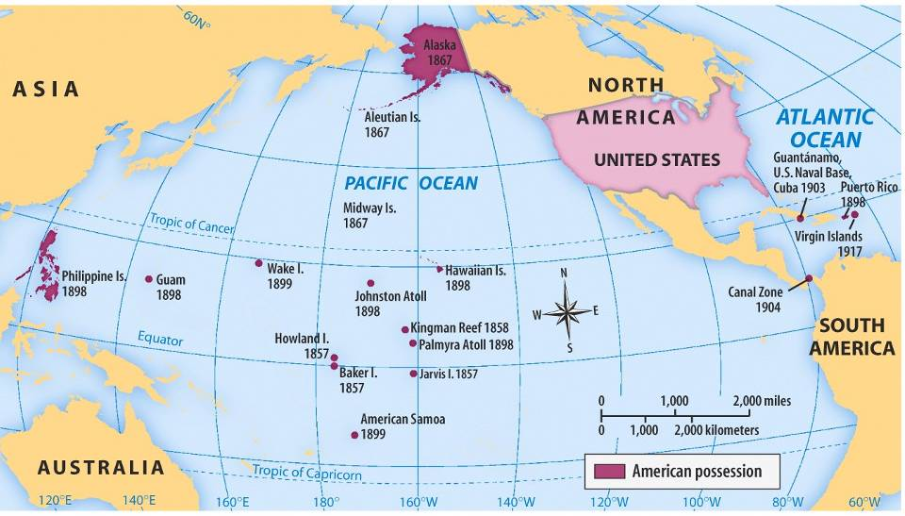
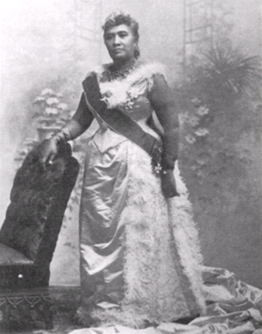
U.S. Imperialism: HAWAII
From 1820 to 1890, Americans moved to Hawaii as missionaries and fruit plantation owners
In 1891, Queen Liliuokalani came to power and tried to reduce the power of Americans living in Hawaii
Americans overthrew Queen Liliuokalani in 1893 and Hawaii was annexed by the USA in 1898

Slide 22
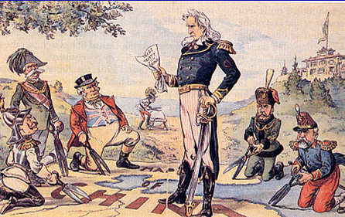
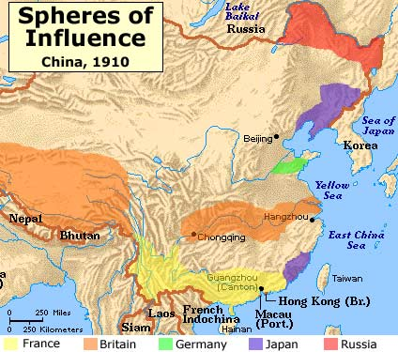
U.S. Imperialism: CHINA
By the 1890s, European imperial powers carved China into spheres of influence, giving them exclusive trade rights in Chinese ports
In 1899, the USA declared an Open Door Policy in China to allow free trade by any nation in any port

Slide 23
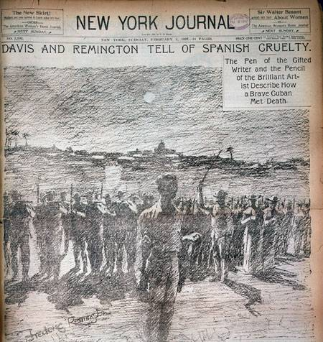
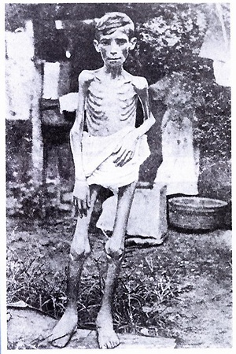
U.S. Imperialism: CUBA
In 1895, Cubans declared their independence from Spain; To put down the revolution, Spain used brutal tactics (like starvation)
U.S. newspapers sensationalized the events in Cuba (known as “yellow journalism”)
Notes:
http://www.history.com/videos/roosevelt-fights-in-spanish-american-war#roosevelt-fights-in-spanish-american-war

Slide 24
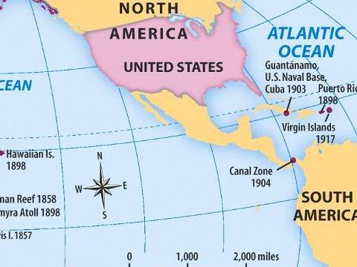
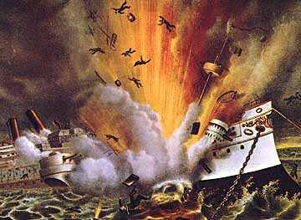
U.S. Imperialism: CUBA
Spanish-American War Video (3.09)
In 1898, the U.S. sent the USS Maine to Cuba to protect American interests there; After the ship mysteriously exploded, Americans declared war on Spain
Notes:
http://www.history.com/videos/roosevelt-fights-in-spanish-american-war#roosevelt-fights-in-spanish-american-war

Slide 25
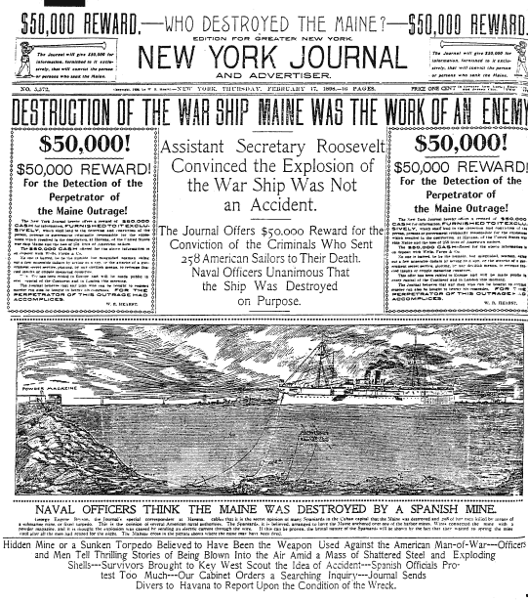
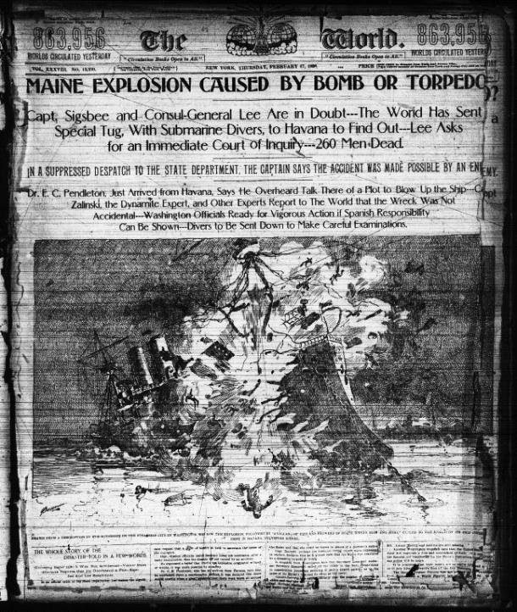
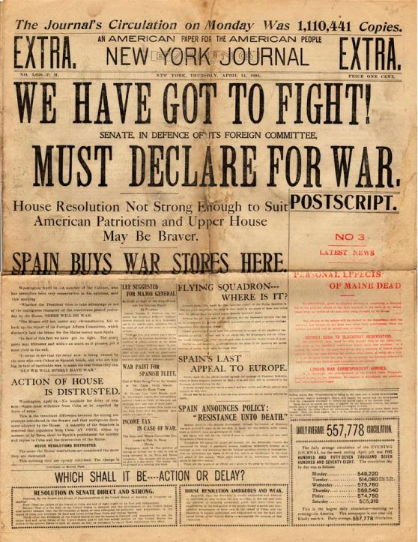
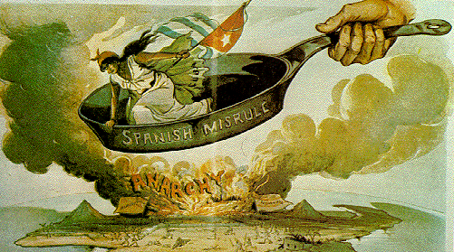
Yellow Journalism contributed to the outbreak of the Spanish-American War

Slide 26
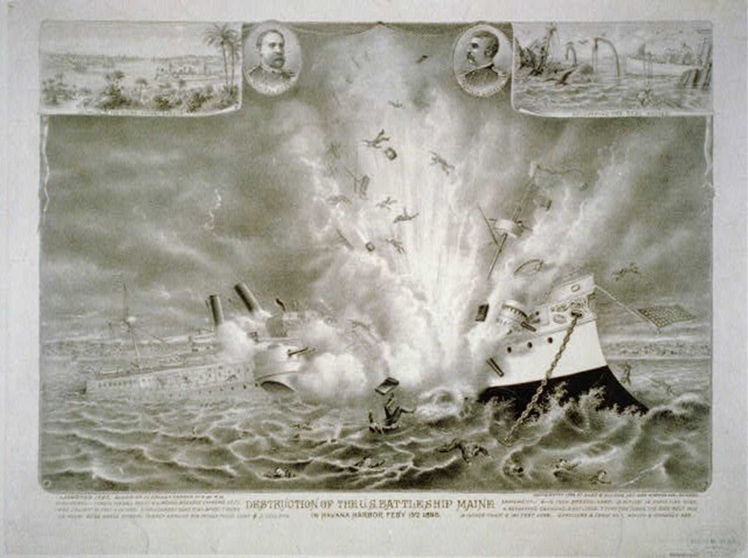

Slide 27
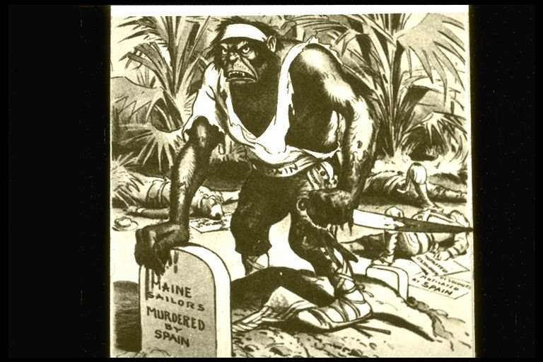

Slide 28
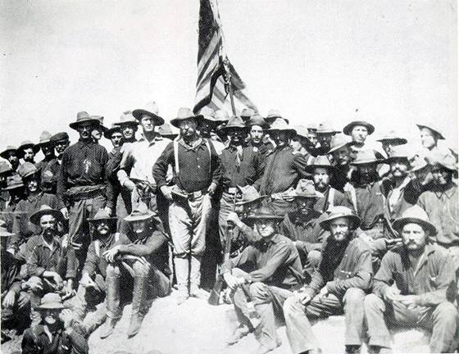
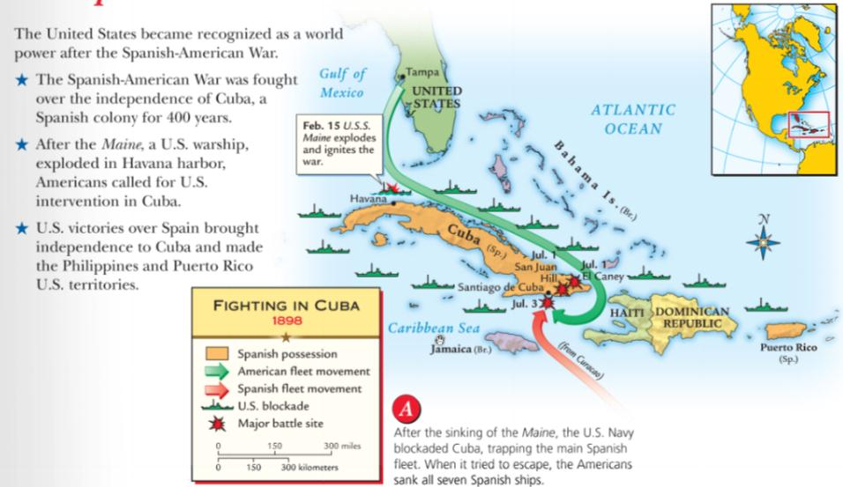
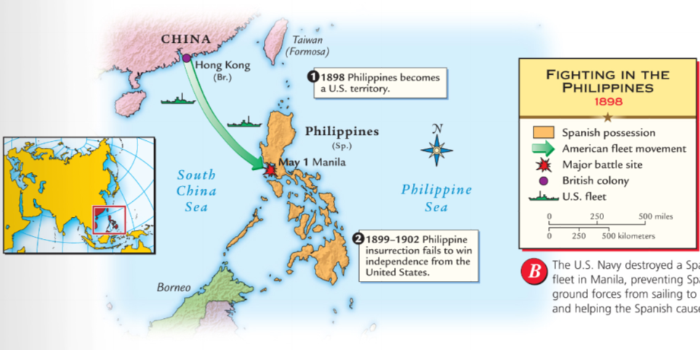
The U.S. easily won the Spanish-American War to free Cuba and the Philippines from Spain
Teddy Roosevelt and the Rough Riders

Slide 29
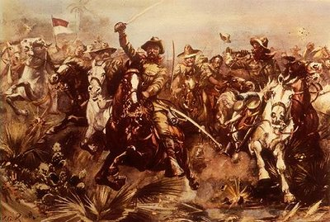
The Myth…

Slide 30
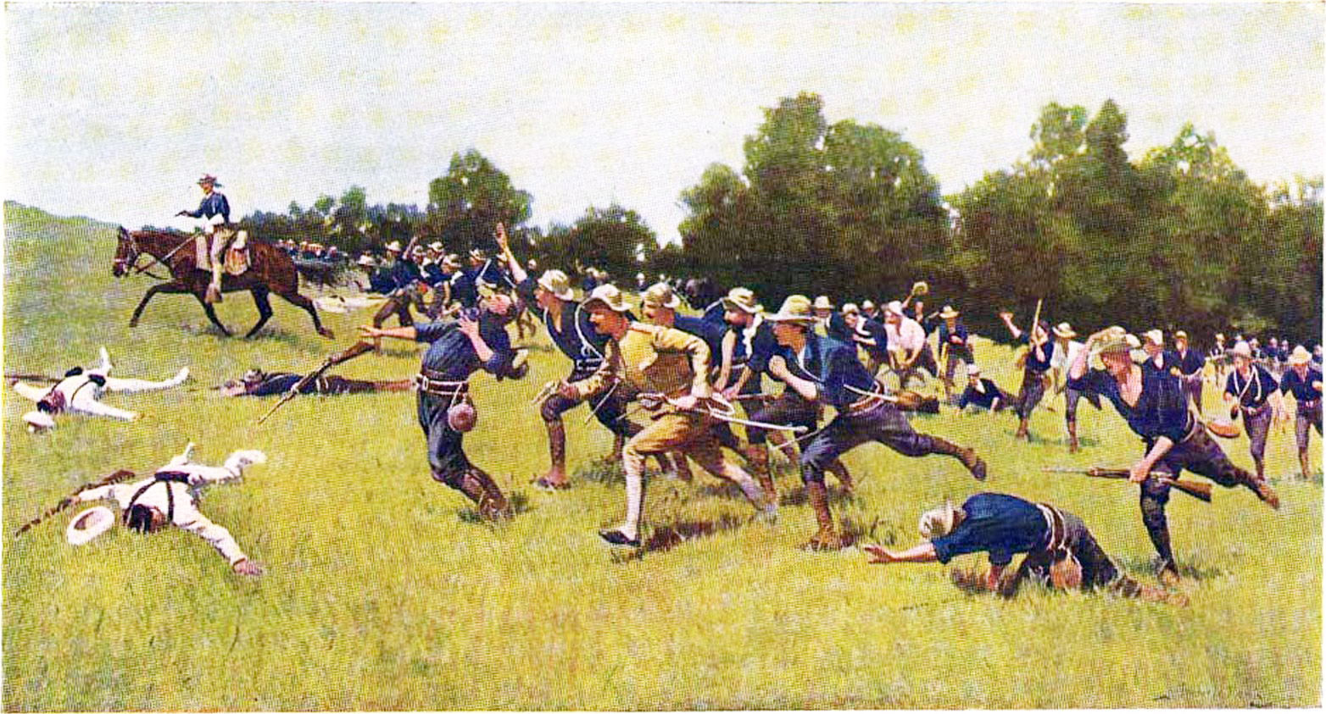
The Reality….on Kettle Hill
How did the myth impact TR?

Slide 31
As a result of the Spanish-American War, Cuba was liberated and the USA annexed the Philippines, Guam, and Puerto Rico

Slide 32
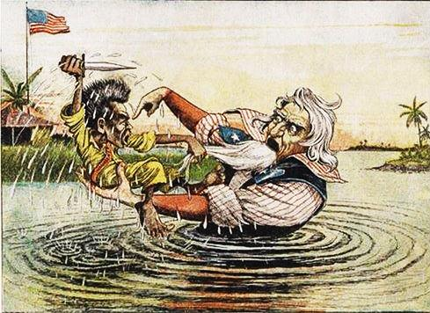
U.S. Imperialism: PHILIPPINES
When the Philippines were annexed and not granted independence, the Filipino War began in 1899
The Filipino-American War lasted 3 years and cost more American lives than the Spanish-American War

Slide 33
When Theodore Roosevelt became president, he used Big Stick Diplomacy to develop an active foreign policy with a strong navy to accomplish goals
“Speak softly and carry a big stick, you will go far”
—TR’s favorite proverb

Slide 34
Theodore Roosevelt and the Roosevelt Corollary
TR added the Roosevelt Corollary to the Monroe Doctrine, giving the USA “police powers” to protect Latin America from European imperialism

Slide 35
The Roosevelt Corollary to the Monroe Doctrine, 1904

Slide 36
U.S. Imperialism: PANAMA CANAL
One of TR’s top objectives was to build a canal in Panama to help U.S. naval and commercial ships
But, the gov’t of Colombia rejected the U.S. offer to build a canal in Panama so TR encouraged Panama to break from Colombia

Slide 37
With U.S. help, Panama gained its independence from Colombia in 1903 and the new government agreed to allow the U.S. to build the canal
Panama Canal Video (3.20)

Slide 38
In 1914, the Panama Canal was finished and controlled by the United States
How the Panama Canal Works

Slide 39
Not all Americans supported imperialism
The Anti-Imperialist League formed in 1899 to fight American annexation of the Philippines
Many argued that the United States had no right to force American culture upon others

Slide 40
By the 20th century, the USA was a world power
The industrial revolution transformed the USA into an economic power
The USA built the world’s third largest navy
America annexed important new territories in the Caribbean and Asia
America asserted itself as an equal to European nations and used its influence to build the Panama Canal, protect Latin America, and trade in Asia

Slide 41
United States: Imperialist or Good Neighbor?
Did the foreign policy actions of the United States reflect selfish, imperialist ambitions or did the USA act as a concerned “big-brother” who was looking after the interests of the western hemisphere?
Use examples from this unit that provide evidence of both arguments.
Take a side and make an argument (thesis)
Hurrah! The Country Is Saved Again

Slide 42
#28

Slide 43
Homework: United States: Imperialist or Good Neighbor?
Did the foreign policy actions of the United States reflect selfish, imperialist ambitions or did the USA act as a concerned “big-brother” who was looking after the interests of the western hemisphere?
Use examples from this unit that provide evidence of both arguments.
Take a side and make an argument (thesis)

