Slide 1
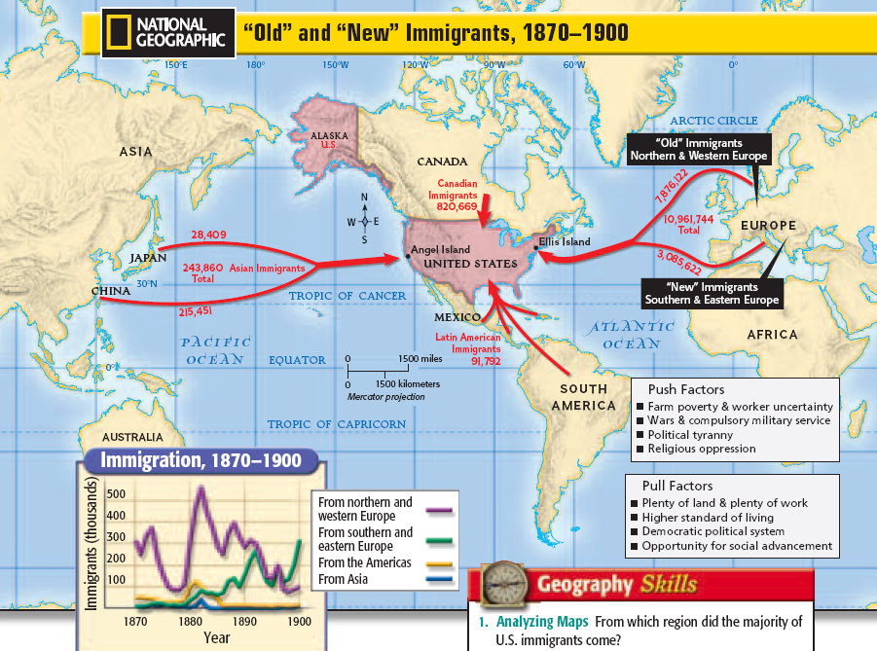
IMMIGRATION
-Old Immigration
Western Europe
-New Immigration, 1890
Eastern Europe
Asian Immigration
Hispanic Immigration

Slide 2
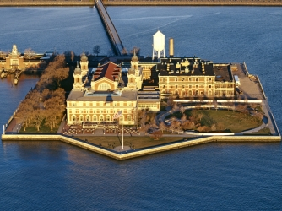
NEW LIFE
-difficult journey
-Ellis Island, NY
immigrant processing
-Angel Island, SF
-Culture Shock
ethnic communities
-Melting Pot
-Nativism
Chinese Exclusion Act

Slide 3
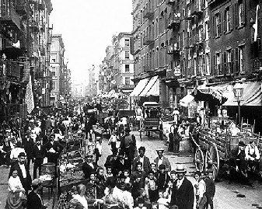
URBAN GROWTH
-urbanization
1/12 in 1840--1/3 by 1900
-immigrant settlement
-decline of farmers
new technology, fewer workers
-closing of the frontier
-industrialization
-cultural opportunities

Slide 4
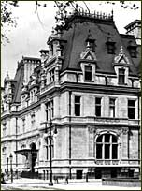
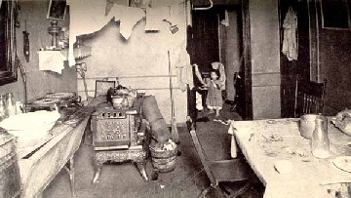
URBAN PROBLEMS
-poor housing
row houses,
tenements
-transportation
-rising crime rates

Slide 5
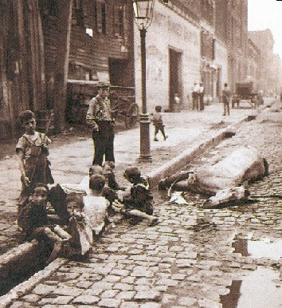
URBAN PROBLEMS
-few city services
water
sanitation
fire
-Chicago 1871
-pollution and disease

Slide 6
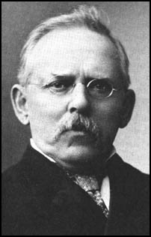
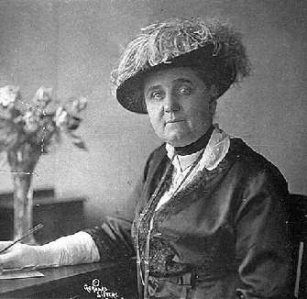
RAISING AWARENESS
-Social Gospel
Christian theme of helping the less fortunate
Salvation Army
-Jacob Riis
“How the Other Half Lives”
-Jane Addams
Hull House, Chicago
Settlement Houses

Slide 7
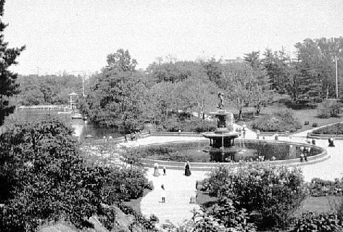
Urban Technology
-skyscrapers
Louis Sullivan
Frank L. Wright
-bridges
-electric transit systems
-urban planning
city parks
Frederick Olmstead

Slide 8
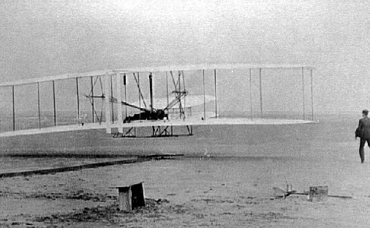
Inventions
-first flight, 1903
Wright Brothers
-air mail
-printing revolutions
-photography
George Eastman
Kodak camera
-radio
Nikola Tesla, Marconi

Slide 9
Public Education
-growth of public education
-most city children could attend school
-increase in high schools
-few opportunities for minorities

Slide 10
Literature and Art
-realism
Thomas Eakins
Ashcan School
-art galleries, public libraries
-Samuel Clemens
-Stephen Crane
-Jack London
-Dime Novels

Slide 11
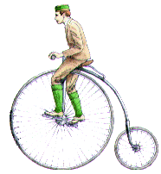
Leisure Time
-Amusement Parks
Coney Island, NY
-bicycle craze
-tennis
-Hershey bars
-Coca-Cola, Pepsi

Slide 12
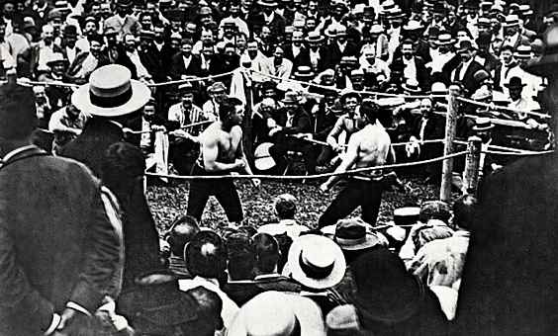
Sports/Entertainment
-baseball
-boxing
-vaudeville, circus
-ragtime music
-motion pictures

Slide 13
Mass Media
-Dime Novels
-Yellow journalism
sensationalism
promotions
-Joseph Pulitzer
-William Randolph Hearst

Slide 14
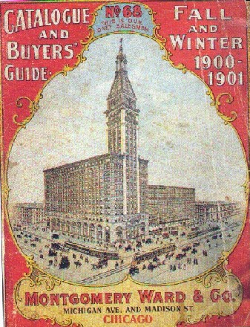
Retail Revolution
-shopping centers
-special districts in urban areas
-department stores
-chain stores
-advertising
-mail order catalogs

