Slide 1
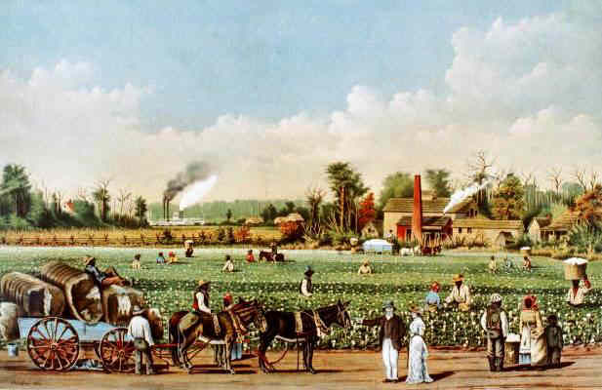
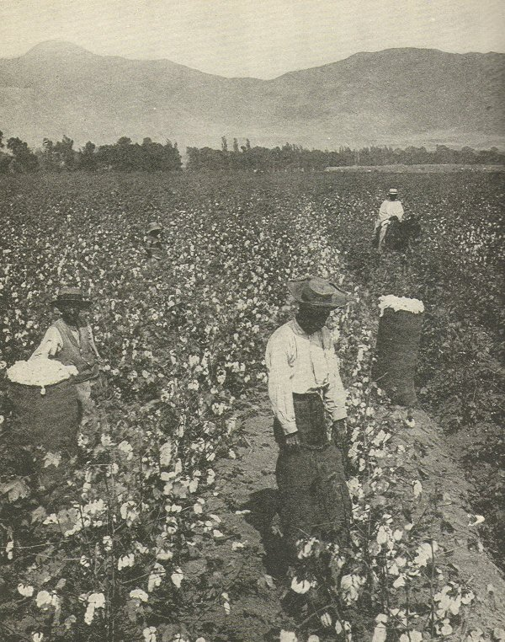
Agricultural South
-growth of cash crops
tobacco, rice, indigo and eventually cotton
-large plantations dominate economy (need for slave labor becomes the “backbone” of economics
-many small farms also
-few towns and cities because of the agricultural lifestyle – some spread out by 20 plus miles (no sense of community)
Plantation economy in the Old South was based on agricultural mass production, usually of cotton, rice, or indigo.

Slide 2
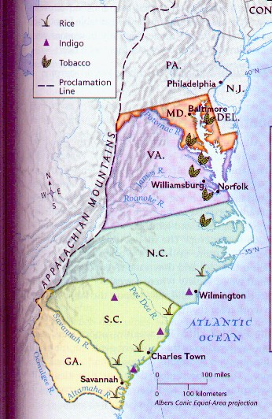
Agricultural South
-growth of cash crops
tobacco, rice, indigo
-large plantations dominate economy
-many small farms also
-few towns and cities because of the agricultural lifestyle

Slide 3
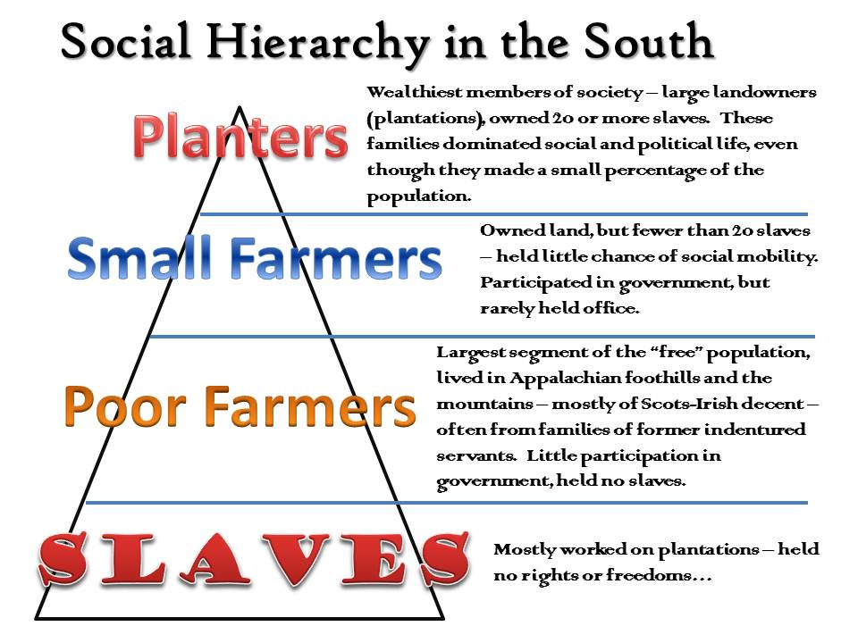
Southern Society
-plantation owners were top of society but made up a small % of population
-small farmers were most of the population and majority did not own slaves
-second class role of women subservient to their husbands; looked down on if not married
-indentured servants #’s began to diminish as slave labor arrived
-slaves were lowest level
-slavery as a “necessary evil” to support the agricultural lifestyle

Slide 4
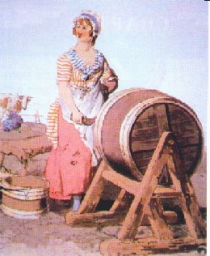
Southern Society
-plantation owners were top of society
-small farmers were most of the population
-second class role of women
-indentured servants
-slaves were lowest level
-slavery as a “necessary evil” to support the agricultural lifestyle

Slide 5
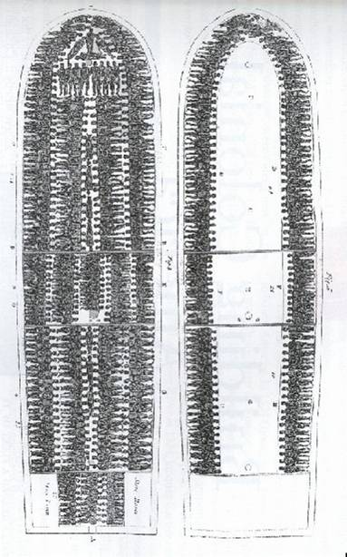
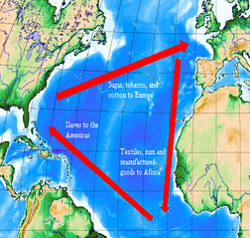
Slavery in America
-slaves would replace Indians and indentured servants
-Triangular Trade
slaves-sugar-rum
-Middle Passage
(voyage from Africa to North America for slaves)
-Slave culture
dance, religion
-slave resistance

Slide 6
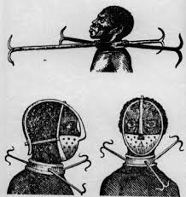
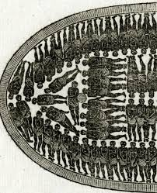
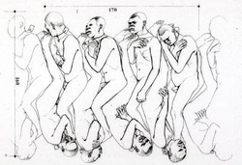
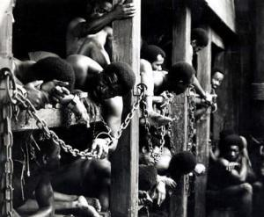

Slide 7
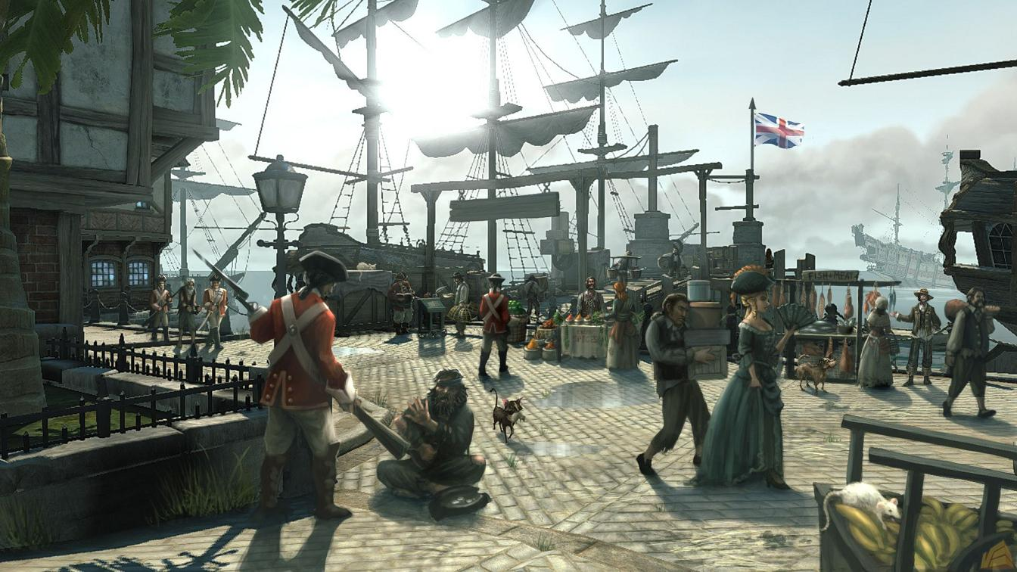
Settlement Patterns
-development of cities
Most were port cities---Boston--New York—Philadelphia—Charleston
-lots of different immigrant groups and religions
-English, Germans, and Irish were largest groups
-resentment begins – segregation by backgrounds (by choice) started in major cities

Slide 8
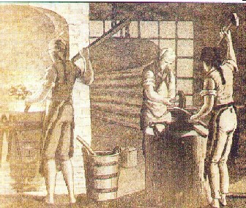
Industrial North
-diversified economy – not as much need for slave labor
-harsher weather conditions – snow/ice; longer winters
-food exports - Fish, whale products, ships, timber products, furs, maple syrup, copper, livestock products, horses, rum, whiskey and beer
-lumber industry
-ship building
-iron making

Slide 9
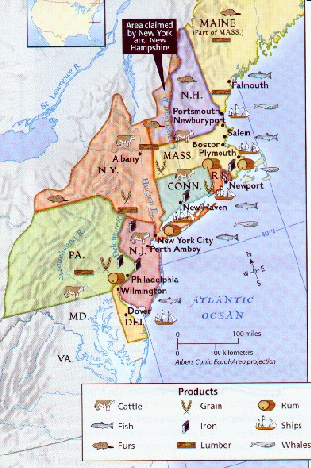
Industrial North
-diversified economy
-harsher weather conditions
-food exports
-lumber industry
-ship building
-iron making

Slide 10
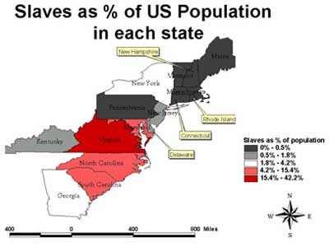
Northern Slavery
-not as much slavery
-crops required less labor
-many house or dock workers
-slaves had more rights than southern slaves but were still not equal with free citizens
-as immigrants provided cheap labor, many slaves were emancipated or slavery abolished in northern areas

Slide 11
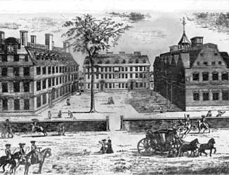
Colonial Education
-rate of education higher in colonies than in England
-religious purposes – Puritans stressed reading of the bible and writing
-establishment of universities
Harvard, Colombia, Princeton, Yale

Slide 12
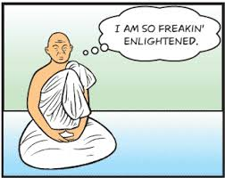
Enlightenment Thought
-stresses the use of reason and scientific method
-led to many scientific discoveries
-Benjamin Franklin as leading American scientist
-also led to increasing education

Slide 13
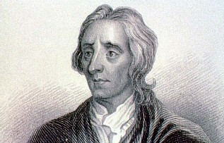
Philosophy
-John Locke
-Natural Rights
life, liberty, property
-Social Contract---an agreement between a people and their gov’t to protect their rights
-Baron Montesquieu
separation of powers in government

Slide 14
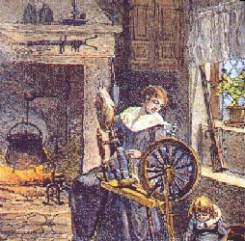
Colonial Women
-few legal rights
Abigail Adams
-many women did many jobs on the farms of the region
-only single women could own property or run a business
-religion also helped to make women submit to men

Slide 15
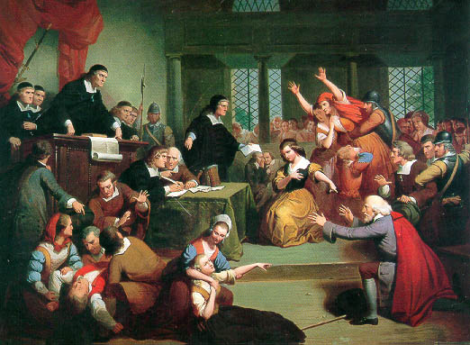
Witch Trials
-1692 - Salem , Massachusetts
-Puritan community standards being challenged
-young girls accused people of being witches
-the accused named other witches
-witches were often executed
-trials later suspended due to poor evidence

Slide 16
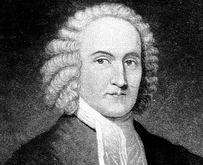
Great Awakening
-a revival of the Puritan faith
-Jonathan Edwards
“Sinners in the Hands of an Angry God”
-George Whitefield
-new religious denominations

