Slide 1
1.2
North American Societies
Around 1492
The varied landscapes of North America encourage the diversity of Native American cultures.

Slide 2
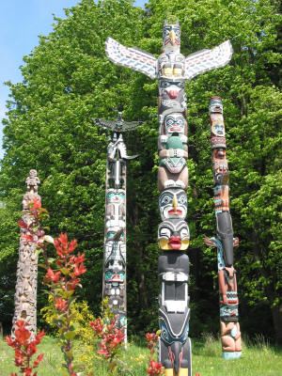
I. Native Americans Live in Diverse Societies
A. California
• Kashaya Pomo hunt waterfowl along northwest coast
• Yurok, Hupa gather acorns in forests, fish in mountain streams
B. Northwest Coast
• Large communities live along streams, seashore, and in forests
• Kwakiutl, Nootka, Haida gather shellfish, hunt whales, otters, seals
• Place totems, symbols of ancestral spirits, on masks, boats, poles
• Potlatches—families give away possessions in special ceremonies

Slide 3
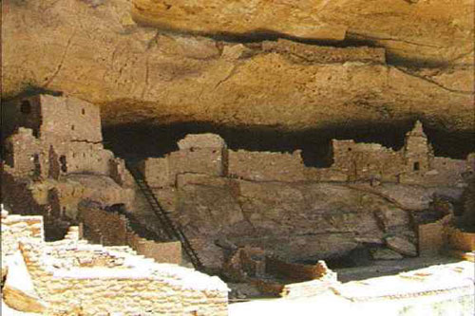
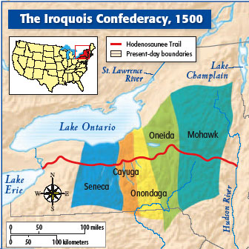
C. Southwest
• By 1300, Pueblo settle near waterways, build multistory houses
• Hopi, Acoma live near cliffs, develop irrigation systems
• Grow corn, beans, squash; build kivas, underground ceremonial rooms
D. Eastern Woodlands
• Tribes like Iroquois build villages in forests; farm, hunt, gather
• People develop woodworking tools, craft objects from wood
• Northeast rely on animals for food, clothing; Southeast, on farming
https://www.youtube.com/watch?v=GKrJdBahvfs

Slide 4
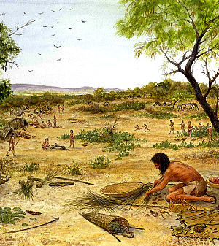
II. Native Americans Share Cultural Patterns
A. Trading Networks
• Trade one of biggest factors in bringing tribes into contact
• Groups specialize in processing or making different products
• Traders on transcontinental network trade items from far-off places
B. Land Use
• Native Americans consider land the source of life, not to be sold
• Disturb it only for important reasons, like food gathering, farming

Slide 5
C. Religious Beliefs
• People believe nature is filled with spirits; ancestors guide people
• Some cultures believe in one supreme being
D. Social Organization
• Bonds of kinship, ties among relatives, ensure customs are passed on
• Division of labor—tasks by gender, age, status— creates social order
• Groups organized by families; some in clans with common ancestor

