Slide 1
1.3
West African Societies Around 1492
West Africa in the 1400s is home to a variety of peoples and cultures.

Slide 2
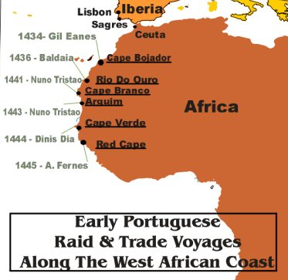
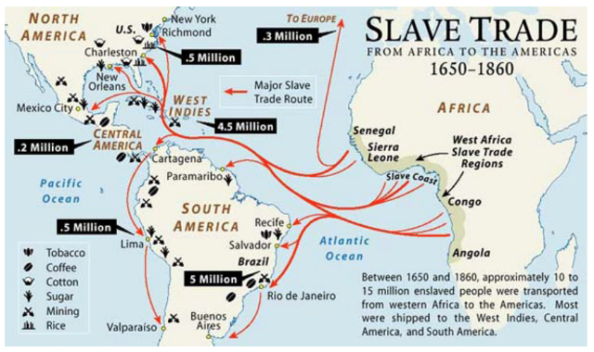
West Africa Connects with the Wider World
A. The Sahara Highway
• Trading network connects West Africa to North Africa, Europe, Asia
• Traders bring Islam; by 1200s court religion of Mali, later Songhai
B. The Portuguese Arrive
• By 1470s, Portuguese have coastal outpost near Akan goldfields
• Direct trade creates closer relations with Europe
• Portuguese begin European trade in West African slaves
• First slaves work on plantation —large farm with single crop
http://www.history.com/shows/mankind-the-story-of-all-of-us/videos/african-slave-trade

Slide 3
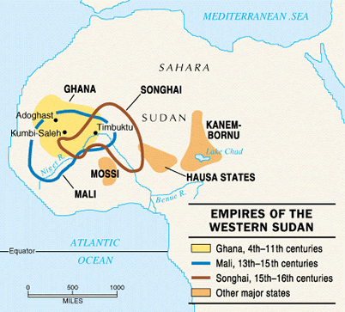
II. Three African Kingdoms Flourish
A. Songhai
• In mid-1400s, Songhai controls Sahara trade; gains wealth, power
• Sunni Ali rules 1464–1492, conquers largest empire in area’s history
• Askia Muhammad is master organizer, devout Muslim, scholar
• Timbuktu again becomes great center of Islamic learning
• Songhai control savanna (dry grasslands) but not forest area
• Other kingdoms thrive in coastal rain forest

Slide 4
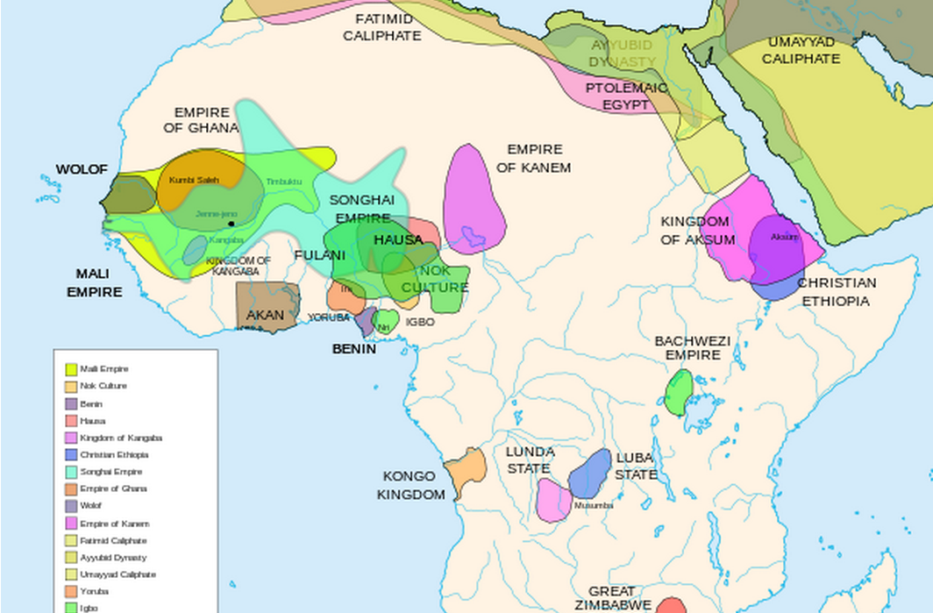
B. Benin
• Forest kingdoms trade with Songhai, North Africa, Portugal
• Benin dominates large area around Niger Delta
• Oba, or ruler, controls trade, district chiefs, metal work
C. Kongo
• Kongo —many small kingdoms in rain forest, lower Zaire (Congo) River
• Manikongo, or ruler, oversees empire of over 4 million people
• Kongo system of government very similar to that of European nations

Slide 5
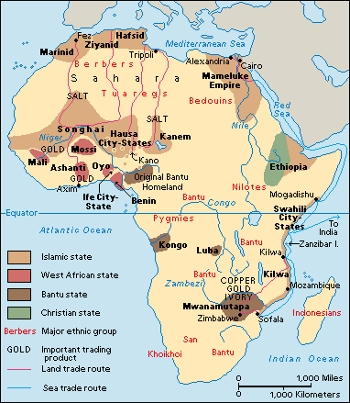
III. West African Culture
A. Family and Government
• Lineage —common descent—decides loyalty, inheritance, marriage
• Oldest relative controls family, represents family in group councils
• Group shares language, history, often territory; has one chief
B. Religion
• All things have spirits; ancestor spirits visit elders in dreams
• Most cultures believe in single creator; spirits do his work
• Christian, Muslim rule of not worshipping spirits source of conflict

Slide 6
C. Livelihood
• Make living from farming, herding, hunting, fishing, mining, trading
• Land owned by family or village; individuals farm plots
D. Use of Slave Labor
• Slaves are lowest social group; slavery not inherited or permanent
• Slaves freed through adoption by owners, marriage, other means

