Slide 1
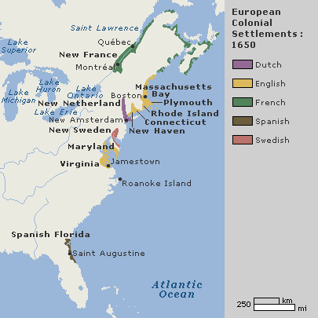
Chapter 2:
The American Colonies Emerge
Spain establishes an American empire, devastating native populations. England forces the Dutch from North America and establishes thirteen colonies.
NEXT

Slide 2
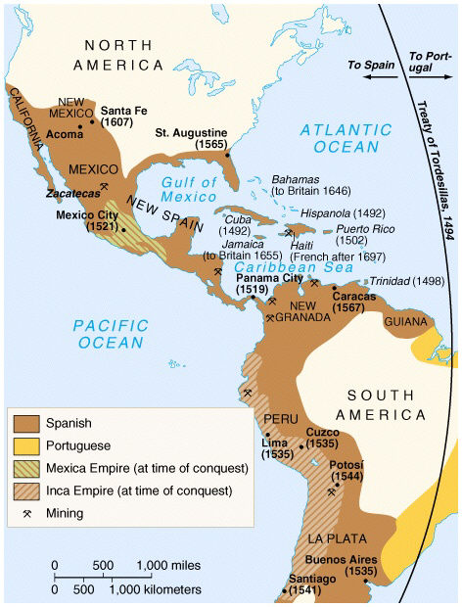
2.1
Spain’s Empire in the Americas
Throughout the 1500s and 1600s, the Spanish conquer Central and portions of North America.
http://www.watchmojo.com/video/id/8296/
NEXT

Slide 3
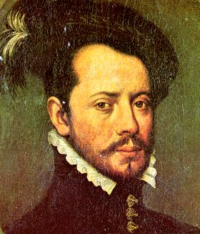
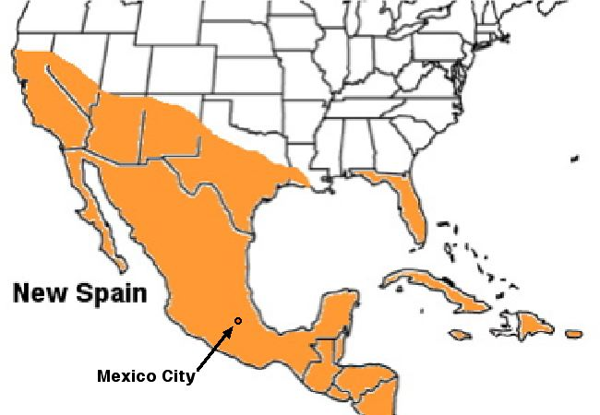
I. The Spanish Claim a New Empire
A. Cortés Subdues the Aztec
• Conquistadors (conquerors)—Spanish explorers, seek gold, silver
• 1519 Hernándo Cortés leads army into Americas, claims land for Spain
• Aztec dominate region; Nahua people who resent Aztec join Cortés
• Montezuma thinks Cortés a god; gives him share of Aztec gold
• In 1520 Aztec rebel; in 1521 Spanish and their allies defeat Aztec
• Cortés founds Mexico City, New Spain colony on Tenochtitlán ruins
http://www.discovery.com/tv-shows/other-shows/videos/assignment-discovery-conquistadors.htm

Slide 4
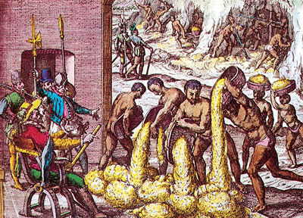
B. Spanish Pattern of Conquest
• Spanish settlers mostly men, called peninsulares; marry native women
• Mestizo —person of mixed Spanish and Native American ancestry
• Landlords use encomienda —force natives to farm, ranch, mine
• Priests object, encomienda abolished; Africans brought as slaves
https://www.youtube.com/watch?v=I9UiqDn46zs

Slide 5
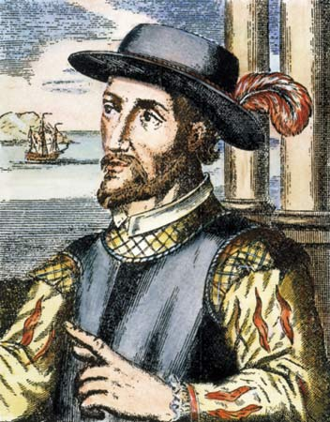
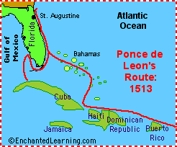
II. The Conquistadors Push North
A. Other Countries Explore North America
• England, France, Netherlands sponsor voyages in 1500s and 1600s
B. Exploring Florida
• Juan Ponce de León discovers and names La Florida (1513)
• Pedro Menéndez de Avilés expels French, founds St. Augustine (1565)
C. Settling the Southwest
• In 1540, Francisco Vásquez de Coronado leads expedition to Southwest
• Pedro de Peralta, governor of New Mexico, Spain’s northern holdings
• He helps found Santa Fe (1609–1610); several missions built in area
http://www.biography.com/people/juan-ponce-de-le%C3%B3n-9444105/videos/ponce-de-leon-landing-in-florida-3348547643

Slide 6
III. Resistance to the Spanish
A. Conflict in New Mexico
• Priests convert many Native Americans, try to suppress their culture
• In 1670s Spanish force natives to pay tribute, do labor for missions
B. Popé’s Rebellion
• Pueblo religious leader Popé heads uprising in New Mexico (1680)
• Pueblo destroy Spanish churches, execute priests, force Spanish out
• Spanish armies regain area 14 years later
https://www.youtube.com/watch?v=E9cX2W91fCk

Slide 7
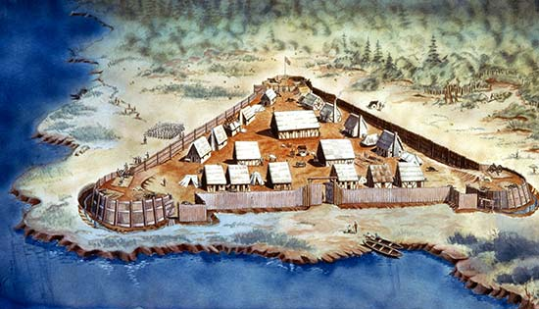
2.2
http://www.havefunwithhistory.com/movies/Jamestown.html
An English Settlement
at Jamestown
The first permanent English settlement in North America is founded at Jamestown, Virginia, in 1607.

Slide 8
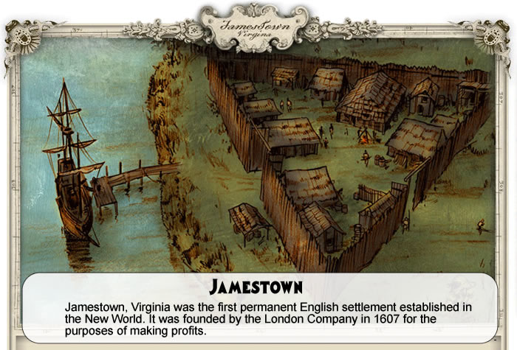
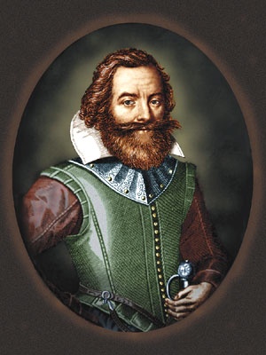
English Settlers Struggle in
North America
A. The Business of Colonization
• Joint-stock companies —investors fund colony, get profits
• In 1607, Virginia Company sends 150 people to found Jamestown
B. A Disastrous Start
• Colonists seek gold, suffer from disease and hunger
• John Smith forces colonists to farm; gets help from Powhatan people
• (1609) 600 colonists arrive; Powhatan destroy farms; “starving time”
https://www.youtube.com/watch?v=3vzlDZDycK8

Slide 9
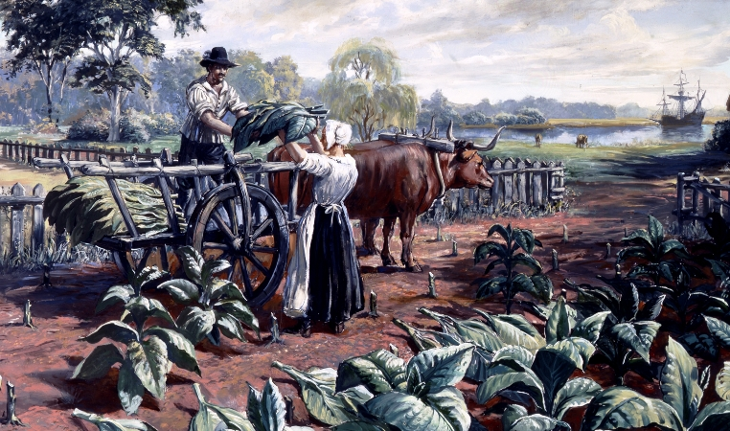
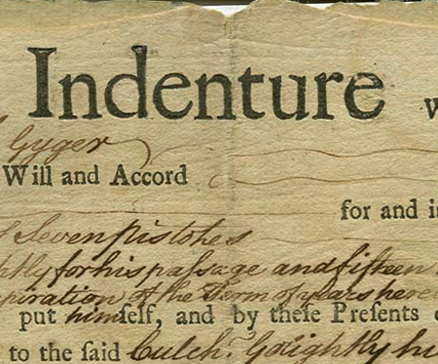
C. Jamestown Begins to Flourish
• New arrivals revive and expand colony; grow tobacco
D. “Brown Gold” and Indentured Servants
• Tobacco becomes profitable; export 1.5 million pounds by late 1620s
• Headright system —purchaser of passage gets 50 acres—lures settlers
• Plantation owners use indentured servants — work 4–7 years for passage

Slide 10
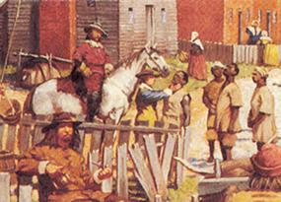
E. The First African Laborers
• First Africans arrive (1619); treated as indentured servants
• Late 1600s, owners begin importing costly slaves because
- indentured population decreases
- colony becomes wealthy

Slide 11
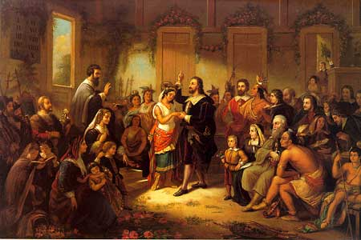
II. The Settlers Clash with Native Americans
A. The English Pattern of Conquest
• English do not live or intermarry with Native Americans
B. The Settlers Battle Native Americans
• Continued hostilities between Powhatan and English after starving time
• 1614 marriage of Pocahontas and John Rolfe creates temporary peace
• Renewed fighting; king makes Virginia royal colony under his control
http://www.biography.com/people/pocahontas-9443116#synopsis

Slide 12
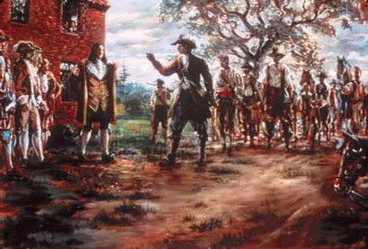
III. Economic Differences Split Virginia
A. Hostilities Develop
• Former indentured people settle frontier, cannot vote, pay high taxes
• Frontier settlers battle natives; tension between frontier, wealthy
• Governor refuses to give money to help frontier fight local natives
B. Bacon’s Rebellion
• Nathaniel Bacon raises army to fight natives on frontier (1676)
• Governor calls Bacon’s army illegal; Bacon sets fire to Jamestown

Slide 13
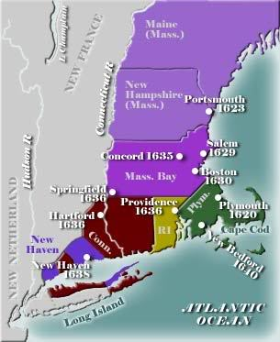
2.3
Puritan New England
English Puritans come to North America, beginning in 1620.
http://www.havefunwithhistory.com/movies/puritanFamily.html

Slide 14
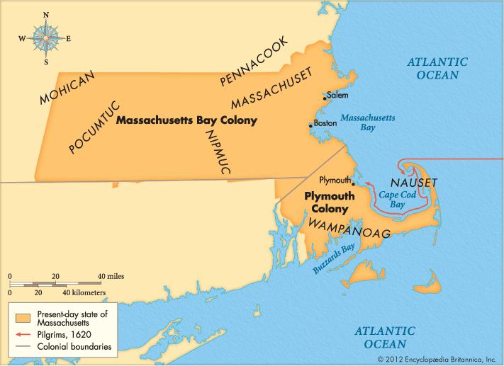
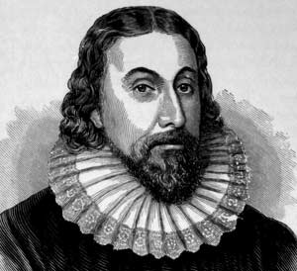
https://www.youtube.com/watch?v=3g9KQxW1cOY
Puritans Create a “New
England”
A. Puritans and Pilgrims
• Puritans, religious group, want to purify Church of England
• Separatists, including Pilgrims, form independent congregations
• In 1620, Pilgrims flee to escape persecution, found Plymouth Colony
B. The Massachusetts Bay Company
• In 1630, joint-stock company founds Massachusetts Bay Colony
• John Winthrop is Puritan colony’s first governor

Slide 15
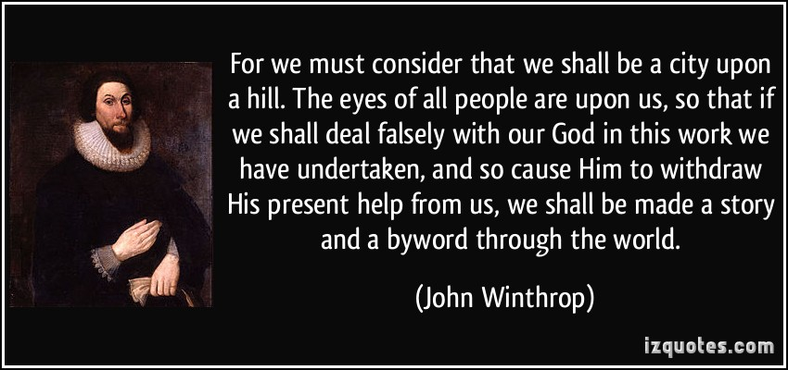
C. “City Upon a Hill”
• Puritan adult males vote for General Court; Court chooses governor
http://video.pbs.org/video/2310716980/
D. Church and State
• Civic officials are church members, have duty to do God’s will
E. Importance of the Family
• Puritans generally migrate as families
• Community makes sure family members behave in “God-fearing” way

Slide 16
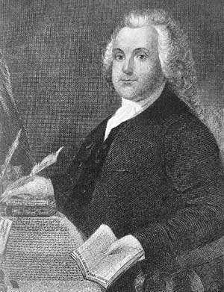
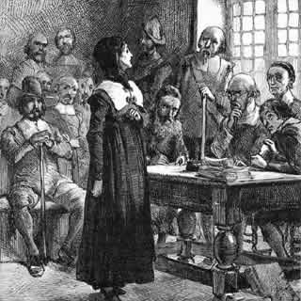
II. Dissent in the Puritan Community
A. The Founding of Providence
• Roger Williams —extreme Separatist minister with controversial views
• General Court orders his arrest; Williams flees
• In 1636 he founds colony of Providence
- negotiates for land with Narragansett tribe
- guarantees separation of church and state, religious freedom
B. Anne Hutchinson Banished
• Anne Hutchinson teaches church, ministers are unnecessary
• Hutchinson banished 1638; family, followers leave colony

Slide 17
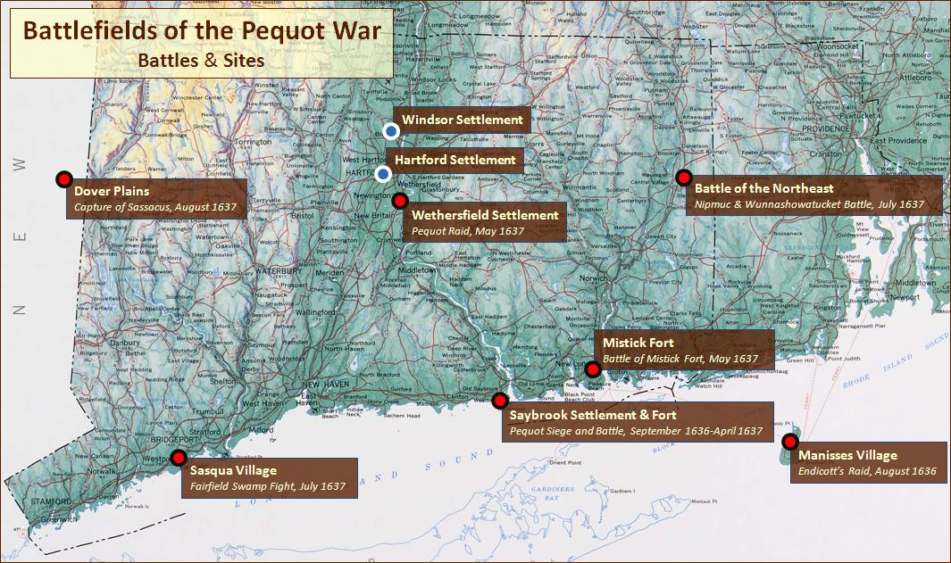
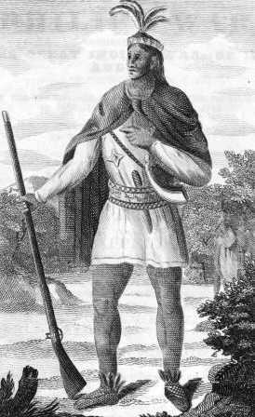
III. Native Americans Resist Colonial Expansion
A. Disputes Over Land
• Settlers spread to western Massachusetts, New Hampshire, Connecticut
• Natives think land treaties temporary, Europeans think permanent
B. The Pequot War
• Pequot War —Pequot takes stand against colonists, nearly destroyed
C. King Philip’s War
• Deprived of land, natives toil for English, must follow Puritan laws
• Wampanoag chief Metacom organizes tribes to wipe out settlers (1675)
• King Philip’s War fierce; hunger, disease, casualties defeat tribes

Slide 18
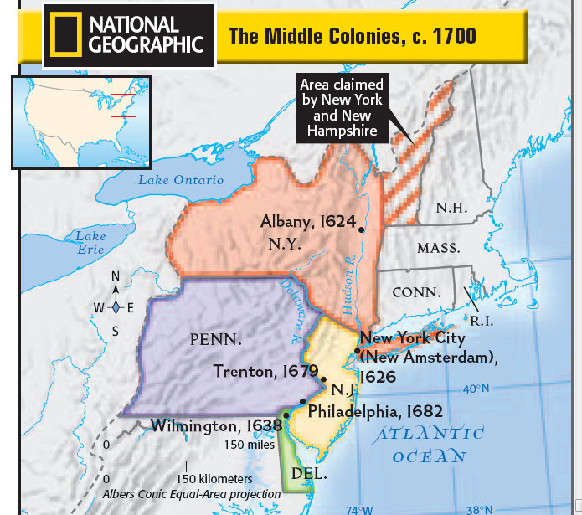
2.4
Settlement of the Middle Colonies
The Dutch settle New Netherland; English Quakers led by William Penn settle Pennsylvania.

Slide 19
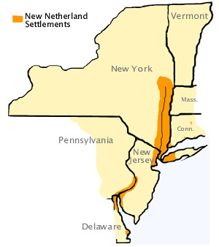
I. The Dutch Found New Netherland
A. A Diverse Colony
• In 1621, the Dutch West India Company colonizes New Netherland
• Settlers from other European countries and Africa welcomed
• Dutch trade for furs with Native Americans
B. English Takeover
• In 1664, duke of York becomes proprietor (owner) of New Netherland
- renames colony New York
- later gives part of land to friends, names it New Jersey

Slide 20
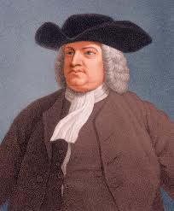
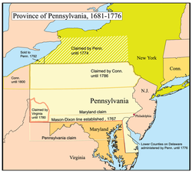
II. The Quakers Settle Pennsylvania
A. Penn’s “Holy Experiment”
• In 1681, William Penn founds Pennsylvania on Quaker principles
• Quakers ideas: equality, cooperation, religious toleration, pacifism
• Pennsylvania meant to be a “holy experiment”
- adult males get 50 acres, right to vote
- representative assembly
- freedom of religion
B. Native American Relations
• Penn treats native people fairly; over 50 years without conflict

Slide 21
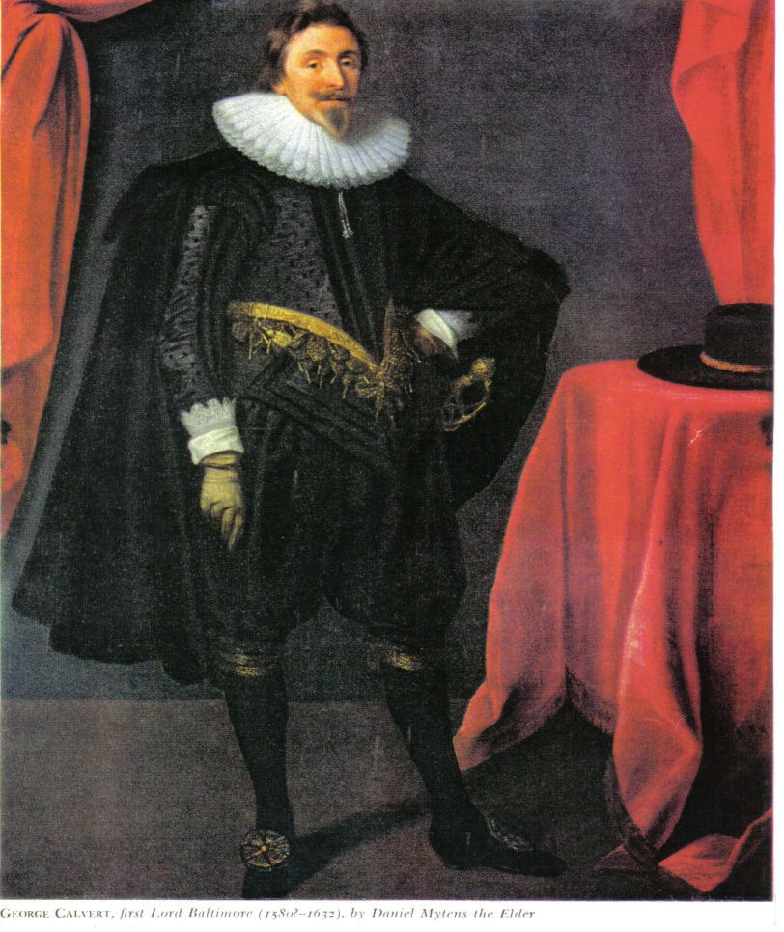
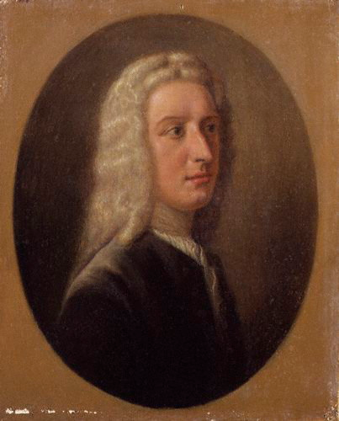
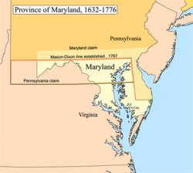
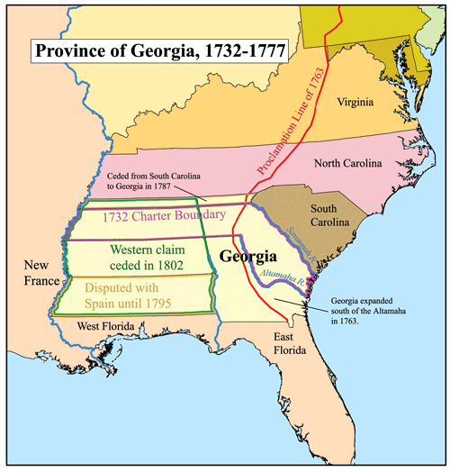
C. A Thriving Colony
• Penn recruits immigrants; thousands of Germans go to Pennsylvania
• Quakers become minority; slavery is introduced
D. Thirteen Colonies
• Lord Baltimore, a Catholic, founds Maryland; has religious freedom
• James Ogelthorpe founds Georgia as haven for debtors
• By 1752, there are 13 British colonies in North America

